Slide 1
Theme: Personal Computer
TASHKENT INFORMATION TECHNOLOGY UNIVERSITY FERGHANA BRANCH
612-12 Shermatov Jahongir

Slide 2
Theme: Personal Computer
personal Computer) is a system, consisting of many components. Some of those components, like Windows XP, and all your other programs, are software. The stuff you can actually see and touch, and would likely break if you threw it out a fifth-story window, is hardware.
Not everybody has exactly the same hardware. But those of you who have a desktop system, like the example shown in Figure 1, probably have most of the components shown in that same figure. Those of you with notebook computers probably have most of the same components. Only in your case the components are all integrated into a single book-sized portable unit.

Slide 3
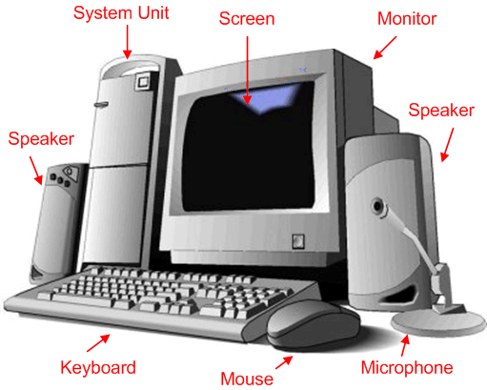

Slide 4
The system unit is the actual computer; everything else is called a peripheral device. Your computer's system unit probably has at least one floppy disk drive, and one CD or DVD drive, into which you can insert floppy disks and CDs. There's another disk drive, called the hard disk inside the system unit, as shown in Figure 2. You can't remove that disk, or even see it. But it's there. And everything that's currently "in your computer" is actually stored on that hard disk. (We know this because there is no place else inside the computer where you can store information!).

Slide 5
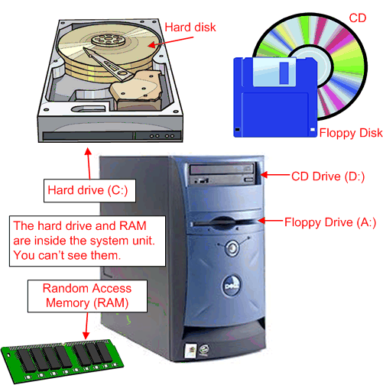

Slide 6
The floppy drive and CD drive are often referred to as drives with removable media or removable drives for short, because you can remove whatever disk is currently in the drive, and replace it with another. Your computer's hard disk can store as much information as tens of thousands of floppy disks, so don't worry about running out of space on your hard disk any time soon. As a rule, you want to store everything you create or download on your hard disk. Use the floppy disks and CDs to send copies of files through the mail, or to make backup copies of important items.

Slide 7
Random Access Memory (RAM)
There's too much "stuff" on your computer's hard disk to use it all at the same time. During the average session sitting at the computer, you'll probably use only a small amount of all that's available. The stuff you're working with at any given moment is stored in random access memory (often abbreviated RAM, and often called simply "memory"). The advantage using RAM to store whatever you're working on at the moment is that RAM is very fast. Much faster than any disk. For you, "fast" translates to less time waiting and more time being productive.

Slide 8
So if RAM is so fast, why not put everything in it? Why have a hard disk at all? The answer to that lies in the fact that RAM is volatile. As soon as the computer is shut off, whether intentionally or by an accidental power outage, every thing in RAM disappears, just as quickly as a light bulb goes out when the plug is pulled. So you don't want to rely on RAM to hold everything. A disk, on the other hand, holds its information whether the power is on or off.

Slide 9
The Hard Disk
All of the information that's "in your computer", so to speak, is stored on your computer's hard disk. You never see that actual hard disk because it's sealed inside a special housing and needs to stay that way. Unlike RAM, which is volatile, the hard disk can hold information forever -- with or without electricity. Most modern hard disks have tens of billions of bytes of storage space on them. Which, in English, means that you can create, save, and download files for months or years without using up all the storage space it provides.

Slide 10
In the unlikely event that you do manage to fill up your hard disk, Windows will start showing a little message on the screen that reads "You are running low on disk space" well in advance of any problems. In fact, if that message appears, it won't until you're down to about 800 MB of free space. And 800 MB of empty space is equal to about 600 blank floppy disks. That's still plenty of room!

Slide 11
The Mouse
Obviously you know how to use your mouse, since you must have used it to get here. But let's take a look at the facts and buzzwords anyway. Your mouse probably has at least two buttons on it. The button on the left is called the primary mouse button, the button on the right is called the secondary mouse buttonor just the right mouse button. I'll just refer to them as the left and right mouse buttons. Many mice have a small wheel between the two mouse buttons, as illustrated in Figure 3.

Slide 12
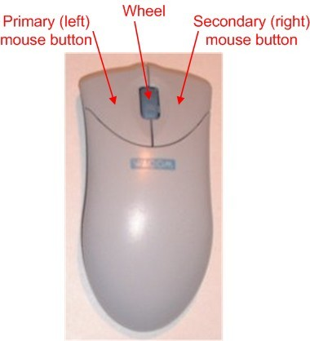

Slide 13
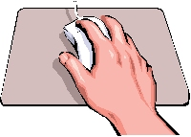
The idea is to rest your hand comfortably on the mouse, with your index finger touching (but not pressing on) the left mouse button. Then, as you move the mouse, the mouse pointer (the little arrow on the screen) moves in the same direction. When moving the mouse, try to keep the buttons aimed toward the monitor -- don't "twist" the mouse as that just makes it all the harder to control the position of the mouse pointer.

Slide 14
If you find yourself reaching too far to get the mouse pointer where you want it to be on the screen, just pick up the mouse, move it to where it's comfortable to hold it, and place it back down on the mousepad or desk. The buzzwords that describe how you use the mouse are as follows:
Point: To point to an item means to move the mouse pointer so that it's touching the item.
Click: Point to the item, then tap (press and release) the left mouse button.
Double-click: Point to the item, and tap the left mouse button twice in rapid succession - click-click as fast as you can.
Right-click: Point to the item, then tap the mouse button on the right.
Drag: Point to an item, then hold down the left mouse button as you move the mouse. To drop the item, release the left mouse button.

Slide 15
The Keyboard
Like the mouse, the keyboard is a means of interacting with your computer. You really only need to use the keyboard when you're typing text. Most of the keys on the keyboard are laid out like the keys on a typewriter. But there are some special keys like Esc (Escape), Ctrl (Control), and Alt (Alternate). There are also some keys across the top of the keyboard labeled F1, F2, F3, and so forth. Those are called the function keys, and the exact role they play depends on which program you happen to be using at the moment.

Slide 16
Most keyboards also have a numeric keypad with the keys laid out like the keys on a typical adding machine. If you're accustomed to using an adding machine, you might want to use the numeric keypad, rather than the numbers across the top of the keyboard, to type numbers. It doesn't really matter which keys you use. The numeric keypad is just there as a convenience to people who are accustomed to adding machines.

Slide 17
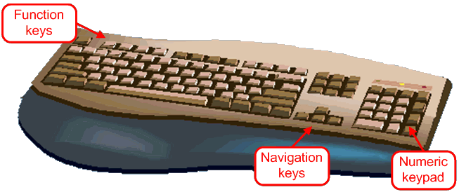
Most keyboards also contain a set of navigation keys. You can use the navigation keys to move around around through text on the screen. The navigation keys won't move the mouse pointer. Only the mouse moves the mouse pointer.

Slide 18
On smaller keyboards where space is limited, such as on a notebook computer, the navigation keys and numeric keypad might be one in the same. There will be a Num Lock key on the keypad. When the Num Lock key is "on", the numeric keypad keys type numbers. When the Num Lock key is "off", the navigation keys come into play. The Num Lock key acts as a toggle. Which is to say, when you tap it, it switches to the opposite state. For example, if Num Lock is on, tapping that key turns it off. If Num Lock is off, tapping that key turns Num Lock on.

Slide 19
Combination Keystrokes (Shortcut keys)
Those mysterious Ctrl and Alt keys are often used in combination with other keys to perform some task. We often refer to these combination keystrokes as shortcut keys, because they provide an alternative to using the mouse to select menu options in programs. Shortcut keys are always expressed as:
key1+key2
where the idea is to hold down key1, tap key2, then release key1. For example, to press Ctrl+Esc hold down the Ctrl key (usually with your pinkie), tap the Esc key, then release the Ctrl key. To press Alt+F you hold down the Alt key, tap the letter F, then release the Alt key.

Slide 20
А.Полвонов

