Slide 1

TASHKENT INFORMATION TECHNOLOGY UNIVERSITY FERGHANA BRANCH
THEME: ABOUT INDIA
Work by: Do’smatov Murodil
Checked by: Obidova G.

Slide 2
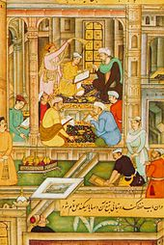
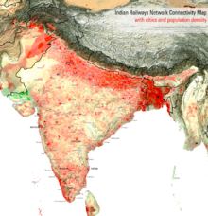
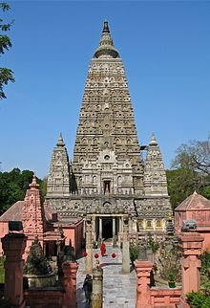
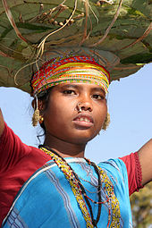
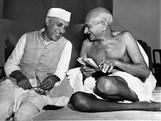
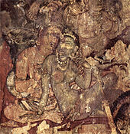
India

Slide 3
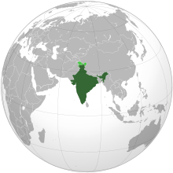
India
Republic of India
भारत गणराज्य
Bhārat Gaṇarājya

Slide 4
Capital New Delhi
28°36.8′N77°12.5′E28.6133; 77.2083
Largest city Mumbai
Official language(s) Hindi, English
•Hindi in the Devanagari script is the official language of the Union and English an additional language for official work.[1]
Recognised regional languages Eighth Schedule
•Assamese
•Bengali
•Bodo
•Dogri
•Gujarati
•Hindi
•Kannada
•Kashmiri
•Konkani
•Maithili
•Malayalam
•Manipuri
•Marathi
•Nepali
•Oriya
•Punjabi
•Sanskrit
•Santali
•Sindhi
•Tamil
•Telugu
•Urdu
National languages
None[3]
Demonym
Indian
Independence
From the United Kingdom
- Declared 15 August 1947
- Republic
26 January 1950
Area
- Total 3,287,263 km2 [A](7th)
1,269,219 sq mi
- Water (%) 9.56
Population
- 2011 census 1,210,193,422[4] (2nd)
- Density 367.4/km2 (31st)
951.5/sq mi
Currency Indian rupee ( ) (INR)
Time zone IST (UTC+05:30)
Drives on the Left
ISO 3166 code
IN
Internet TLD
.in

Slide 5
India ( ^{i}/ˈɪndiə/), officially the Republic of India (Hindi: भारत गणराज्य, Bhārat Gaṇarājya),^{[c]} is a country in South Asia. It is the seventh-largest country by geographical area, the second-most populous country with over 1.2 billion people, and the most populous democracy in the world. Bounded by the Indian Ocean on the south, the Arabian Sea on the south-west, and the Bay of Bengal on the south-east, it shares land borders with Pakistan to the west;^{[d]} China, Nepal, and Bhutan to the north-east; and Burma and Bangladesh to the east. In the Indian Ocean, India is in the vicinity of Sri Lanka and the Maldives; in addition, India's Andaman and Nicobar Islands share a maritime border with Thailand and Indonesia.
Home to the ancient Indus Valley Civilisation and a region of historic trade routes and vast empires, the Indian subcontinent was identified with its commercial and cultural wealth for much of its long history.^{[8]} Four of the world's major religions—Hinduism, Buddhism, Jainism, and Sikhism—originated here, whereas Zoroastrianism, Christianity, and Islam arrived in the 1st millennium CE and also helped shape the region's diverse culture. Gradually annexed by and brought under the administration of the British East India Company from the early 18th century and administered directly by the United Kingdom from the mid-19th century, India became an independent nation in 1947 after a struggle for independence that was marked by non-violent resistance and led by Mahatma Gandhi.
The Indian economy is the world's tenth-largest by nominal GDP and third-largest by purchasing power parity (PPP). Following market-based economic reforms in 1991, India became one of the fastest-growing major economies; it is considered a newly industrialised country. However, it continues to face the challenges of poverty, illiteracy, corruption, and inadequate public healthcare. A nuclear weapons state and a regional power, it has the third-largest standing army in the world and ranks ninth in military expenditure^{[9]} among nations. India is a federal constitutional republic governed under a parliamentary system consisting of 28 states and 7 union territories. It is one of the five BRICS nations. India is a pluralistic, multilingual, and multiethnic society. It is also home to a diversity of wildlife in a variety of protected habitats.

Slide 6
Etymology
The name India is derived from Indus, which is derived from the Old Persian word Hindu, from Sanskrit Sindhu (सिन्धु), the historic local appellation for the Indus River.^{[10]} The ancient Greeks referred to the Indians as Indoi (Ινδοί), the people of the Indus.^{[11]} The Constitution of India and usage in many Indian languages also recognises Bharat (pronounced [ˈbʱaːrət̪] ( listen)) as an official name of equal status.^{[12]} The name Bharat is derived from the name of the legendary king Bharata in Hindu scriptures. Hindustan ([ɦɪnd̪ʊˈst̪aːn] ( listen)), originally a Persian word for "Land of the Hindus" and referring to North India and Pakistan before 1947, is also occasionally used as a synonym for all of India.

Slide 7
History
Ancient India
The earliest anatomically modern human remains found in South Asia are from approximately 30,000 years ago.^{[14]} Nearly contemporaneous Mesolithic rock art sites have been found in many parts of the Indian subcontinent, including at the Bhimbetka rock shelters in Madhya Pradesh.^{[15]} Around 7000 BCE, the first known neolithic settlements appeared on the subcontinent in Mehrgarh and other sites in western Pakistan.^{[16]} These gradually developed into the Indus Valley Civilisation,^{[17]} the first urban culture in South Asia,^{[18]} which flourished during 2500–1900 BCE in Pakistan and western India.^{[19]} Centred around cities such as Mohenjo-daro, Harappa, Dholavira, and Kalibangan, and relying on varied forms of subsistence, the civilisation engaged robustly in crafts production and wide-ranging trade.^{[18]}
Paintings at the Ajanta Caves in Aurangabad, Maharashtra, 6th century.

Slide 8
History
Ancient India
During the period 2000–500 BCE, many regions of the subcontinent evolved from copper age to iron age cultures.^{[20]} The Vedas, the oldest scriptures of Hinduism,^{[21]} were composed during this period, and historians have analyzed these to posit a Vedic culture in the Punjab region and the upper Ganges Plain.^{[20]} Most historians also consider this period to have encompassed several waves of Indo-Aryan migration into the subcontinent from the north-west.^{[21]} The caste system, which created a hierarchy of priests, warriors, and free peasants, but which excluded indigenous peoples by labeling their occupations impure, arose during this period.^{[22]} In the Deccan, archaeological evidence from this period suggests the existence of a chiefdom stage of political organisation.^{[20]} In South India, the large number of megalithic monuments found from this period,^{[23]} and nearby evidence of agriculture, irrigation tanks, and craft traditions suggest progression to sedentary life.^{[23]}
By the 5th century BCE, the small chiefdoms of the Ganges Plain and the north-west regions had consolidated into 16 major oligarchies and monarchies called Mahajanapadas.^{[24][25]} The emerging urbanisation as well as the orthodoxies of the late Vedic age created the religious reform movements of Buddhism and Jainism.^{[26]} Buddhism, based on the teachings of India's first historical figure, Gautam Buddha, attracted followers from all social classes excepting the middle;^{[26][27]} Jainism came into prominence around the same time during the life of its exemplar,

Slide 9
History
Ancient India
Mahavira.^{[28]} In an age of increasing urban wealth, both religions held up renunciation as an ideal,^{[29]} and both established long-lasting monasteries.^{[24]} Politically, by the 3rd century BCE, the kingdom of Magadha had annexed or reduced other states to emerge as the Mauryan Empire.^{[24]} The empire was once thought to have controlled most of the subcontinent excepting the far south, but its core regions are now thought to have been separated by large autonomous areas.^{[30][31]} The Maurya kings are known as much for their empire building and determined management of public life as for Ashoka the Great's renunciation of militarism and far-flung advocacy of the Buddhist dhamma.^{[32][33]}
The Sangam literature of the Tamil language reveals that, between 200 BCE and 200 CE, the southern peninsula was being ruled by the Cheras, the Cholas, and the Pandyas, dynasties that traded extensively with the Roman Empire and with West and South-East Asia.^{[34][35]} In North India, Hinduism asserted patriarchal control within the family leading to increased subordination of women.^{[36][24]} By the 4th and 5th centuries, the Gupta Empire had created a complex administrative and taxation system in the greater Ganges Plain that became a model for later Indian kingdoms.^{[37][38]} Under the Guptas, a renewed Hinduism based on devotion rather than the management of ritual began to assert itself.^{[39]} The renewal was reflected in a flowering of sculpture and architecture, which found patrons among an urban elite.^{[38]} Classical Sanskrit literature flowered as well, and Indian science, astronomy, medicine, and mathematics made significant advances.

Slide 10
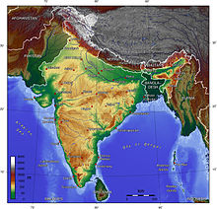
Geography
India comprises the bulk of the Indian subcontinent and lies atop the minor Indian tectonic plate, which in turn belongs to the Indo-Australian Plate.^{[101]} India's defining geological processes commenced 75 million years ago when the Indian subcontinent, then part of the southern supercontinent Gondwana, began a north-eastward drift across the then-unformed Indian Ocean that lasted fifty million years.^{[101]} The subcontinent's subsequent collision with, and subduction under, the Eurasian Plate bore aloft the planet's highest mountains, the Himalayas. They abut India in the north and the north-east.^{[101]} In the former seabed immediately south of the emerging Himalayas, plate movement created a vast trough that has gradually filled with river-borne sediment;^{[102]} it now forms the Indo-Gangetic Plain.^{[103]} To the west lies the Thar Desert, which is cut off by the Aravalli Range.^{[104]}
The original Indian plate survives as peninsular India, the oldest and geologically most stable part of India and extends as far north as the Satpura and Vindhya ranges in central India. These parallel ranges run from the Arabian Sea coast in Gujarat in the west to the coal-rich Chota Nagpur Plateau in Jharkhand in the east.^{[105]} To the south the remaining peninsular landmass, the Deccan Plateau, is flanked on the west and east by the coastal ranges, the Western and Eastern Ghats respectively;^{[106]} the plateau contains the nation's oldest rock formations, some over one billion years old. Constituted in such fashion, India lies to the north of the equator between 6° 44' and 35° 30' north latitude^{[e]} and 68° 7' and 97° 25' east longitude.

Slide 11
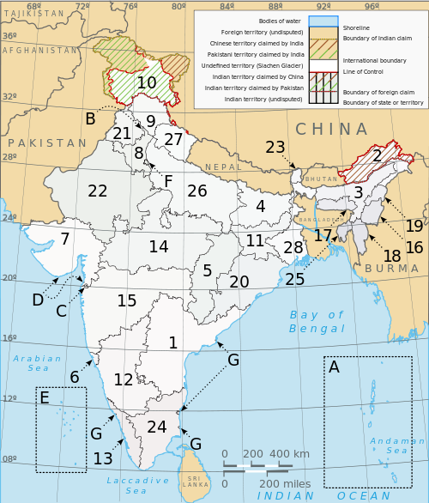
Subdivisions
India is a federation composed of 28 states and 7 union territories.^{[159]} All states, as well as the union territories of Pondicherry and the National Capital Territory of Delhi, have elected legislatures and governments, both patterned on the Westminster model. The remaining five union territories are directly ruled by the Centre through appointed administrators. In 1956, under the States Reorganisation Act, states were reorganised on a linguistic basis.^{[160]} Since then, their structure has remained largely unchanged. Each state or union territory is further divided into administrative districts. The districts in turn are further divided into tehsils and ultimately into villages.
States
Andhra Pradesh Arunachal Pradesh Assam Bihar Chhattisgarh Goa Gujarat | Haryana Himachal Pradesh Jammu and Kashmir Jharkhand Karnataka Kerala Madhya Pradesh | Maharashtra Manipur Meghalaya Mizoram Nagaland Orissa Punjab | Rajasthan Sikkim Tamil Nadu Tripura Uttar Pradesh Uttarakhand West Bengal
Union territories
Andaman and Nicobar Islands Chandigarh Dadra and Nagar Haveli Daman and Diu Lakshadweep National Capital Territory of Delhi Pondicherry

Slide 12
А. Дилшодов

