Slide 1
THE MINISTRY OF HIGHER AND SECONDARY SPECIALIZED EDUCATION OF THE REPUBLIC OF UZBEKISTAN
THE UZBEK STATE WORLD LANGUAGES UNIVERSITY
ENGLISH FACULTY II
THE DEPARTMENT ENGLISH STYLISTICS

Slide 2
“COGNITIVE STYLISTICS ANALYSIS OF LITERARY TEXT”
QUALIFICATION PAPER
Student: Xodjayeva Gulhayo
Scientific Advisor:
Ph.D. N.Z.Normurodova

Slide 3
Chapter I Theoretical research on investigation
1.1. New perspective directions in antropothentric paradigm
1.1.1. Communicative stylistics and pragmatic linguistics
1.1.2. Cognitive aspects of stylistics
1.2. Text categories: theoretical and practical assumption
1.3. Literary text in the light of modern trends in linguistics
Chapter II Linguo cognitive interpretation of literary text
2.1. Emotiveness as a means of implicitness
2.2. Intertextuality as a main signal of conceptualization
Chapter III Cognitive principle of foregrounding as a stylistic value of perception and interpretation in English and Uzbek literary texts
3.1. Convergence of stylistic devices and as an indicator of implicit meaning
3.2. Contrast as a cognitive principle in decoding stylistics

Slide 4
The topicality is determined insufficient knowledge convergence of stylistic devices, the defeated expectancy, coupling as a means of foregrounding in the literary text, as well as the fact that the study of cognitive significance stylistically marked units and their role in a literary text is one of the urgent problems of modern style.

Slide 5
The novelty of the work is determined by the cognitive approach to the problem of conceptual analysis and interpretation of literary text.

Slide 6
the convergence of stylistic devices, defeated expectancy, coupling and contrast, intertextuality as means of foregrounding in the literary text.
stylistic and cognitive functions of cognitive categories in the literary text
The object of research
The subject of research

Slide 7
1.1 The main new trends in linguistics
Social linguistics
Cognitive linguistics
Linguoculturology
Pragmatics

Slide 8
obligatory
integrity
informativity
cohesion

Slide 9
optional
subjective modality
the author’s image
implicitness

Slide 10
Emotivness
stylistically marked units
: emotively marked lexicon, word-formation means, neologisms, caressing words, zoonisms, somatisms
expressive means in a form of dimunitiveness
stylistic categories, such as implicitness, image structure of literary text
culturally marked units
realiae. national context, speech etiquette, concepts
the poetic detail:
Depicting detail;
Characterogecial detail
Auhenticity detail;
The details of implicitness;

Slide 11
Emotive meaning
Integrations
O! Alas! Hey
Exclamatory words
Good! Well, Hear, etc.
Oaths and swear words
The devil, Christ, God etc.
Qualitative and intensifying adjectives and adverbs
Awfully, terrible, fine, fantastic
Nominal meaning
Treated as proper noun
It is spelt by a capital letter, e.g. Long fellow, Black Sea, Smith have nominal meanings
It will always be secondary to the target meaning

Slide 12
Devotion
Dedication
Sacrifice
2.2. Intertextuality as a main signal of conceptualization
Wise Magi Della and Jim
Innocence
True love
Loyalty
Oblation
Offering
Tribute
Adore
Love
Generosity
Donation
Gift
Respect

Slide 13
3.1. Convergence of stylistic devices and as an indicator of implicit meaning
Wonder of wonder
Princes
Sunlight
BEAUTY
Genius
Spring – time
Reflection of the moon in the dark waters

Slide 14
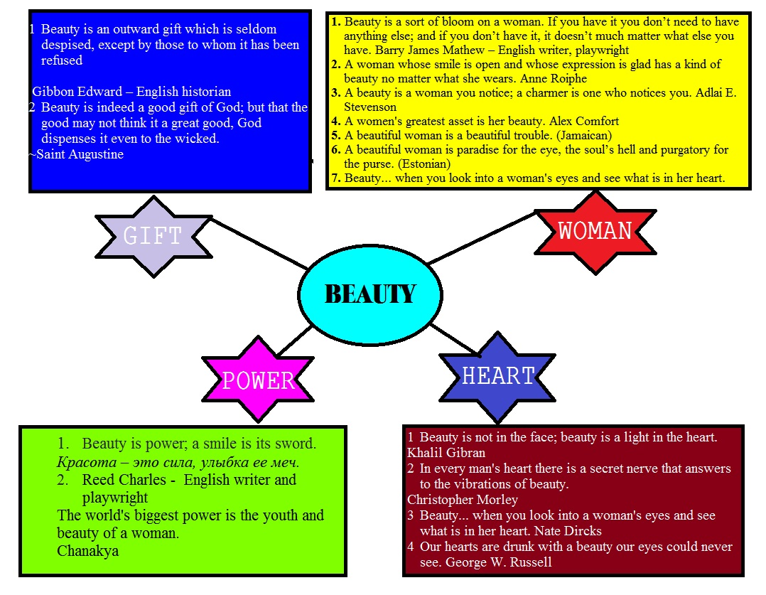
Conceptual mapping

Slide 15
Stage
Lesson
Teacher
Birth and death
Music
Money
Art
Life
Child
Phrase
Nature
Book
Time
Pain
Game
Grape
fruit

Slide 16
3.2. Contrast as a cognitive principle in decoding stylistics
One of the main tasks of the research is to consider contrast as one of the cognitive principles of distributing information in the text. Contrast is considered from different points of view : philosophy, logic, linguistics, etc. In general, “contrast” is understood as: confrontation of two semantically and stylistically opposed language patterns.

Slide 17
The pre-last line includes the intertextual feature by using the hero “Go’ro’g’li” from Uzbek dostons into this poem.
Quvnoq,-Shirin so’z, Shod, Xushchaqchaq, - Yuzi yorug’, -Ulfat, -So’zamon,- Ko’ngli ochiq…
-Faqir, -Miskin, -Bechora, -Notavon, -Gado, -Kambag’al, -Nochor,-Qo’li qisqa, -Yetim,-Homiysiz…
G’amgin
odamzod
Conceptual antonyms
-Urush, -To’polon, -Janjal, -Kurash, -Tortishuv, -Kelishmovchilik, - To’qnashuv, -G’animlik, -Dushmanlik…
-Saxiy, -Ochiq ko’ngil, -Samimiy, -Sofdil, -Beg’ubor, -Ko’ngli sof,-Oqko’ngil,- Dilkash- Qalbi pok, -Niyati xolis, -Insonparvar…
Omonlik
Baxil

Slide 18
Thank you for your attention!!!
☺

