Slide 1
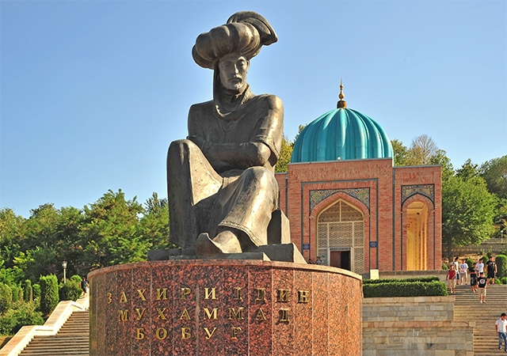
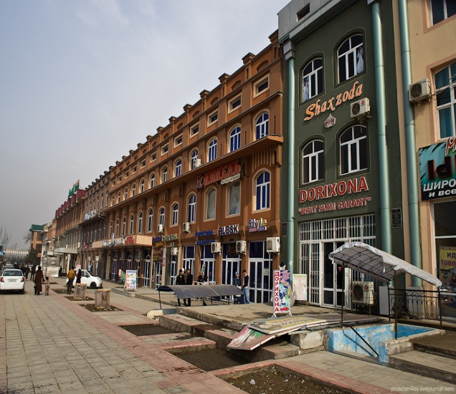
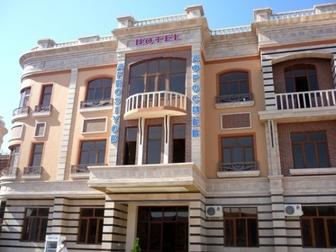
Cities and countrylife: Andijan
Done by Djumayeva Guli
Teacher : Hasanova X.

Slide 2
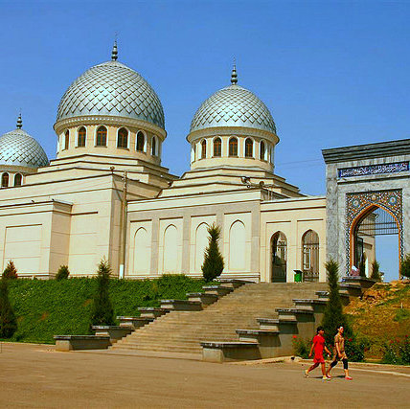
Andijan
Andijan is a city and administrative center in far eastern Uzbekistan in Andijan province, is situated in the Southeast of the Fergana Valley and is surrounded by high mountains and hills. Andijan is about 475 km east of Tashkent, and about 45 km west of Osh, Kyrgyzstan. Andijan is a center of oil production and has a few oil refineries. Cotton groeing and processing remain the dominant economic activities.

Slide 3
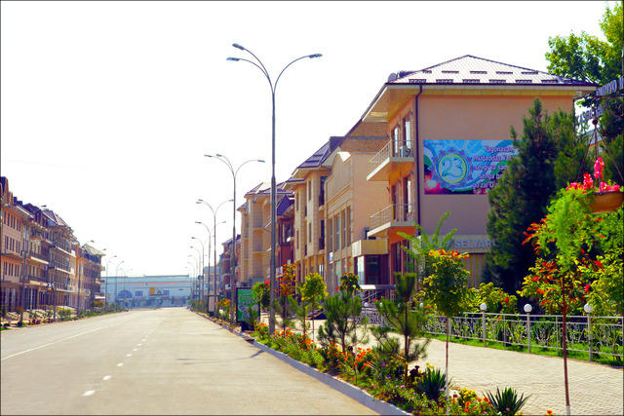
While visiting Istiqlol Street, the president gave a few reccomendations on” improving the way the street looks, the buildings’ outer appearances, mowing the lawns and increasing the greenery”. There is no single city resident and there is no car on Istiqlol Street on any of the pictures. Although the following image depicts a community center, there was not a single member, let alone the entire community, to be seen during the president’s visit.

Slide 4
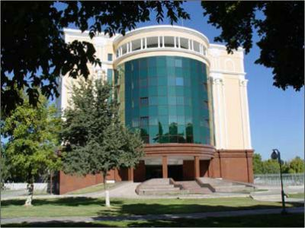
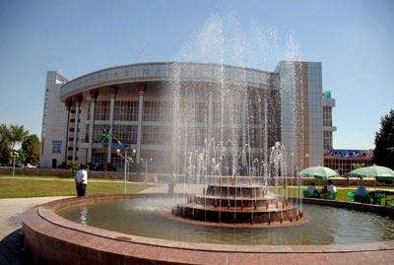
In reality, the city of Andijan is a very densely populated and bustling city: fill streets, markets full of goods and customers, and children play in the streets.
Andijan is one of the oldest cities in the Fergana Valley. In some parts of the city, archeologists have found items dating back to the 7th and 8th centuries. This city is perhaps best known as the birthplace of Babur who, following a series of setbacks, finally succeede in laying the basis for the Mughal dynasty in the Indian Subcontinent and became the first Mughal emperor.

Slide 5
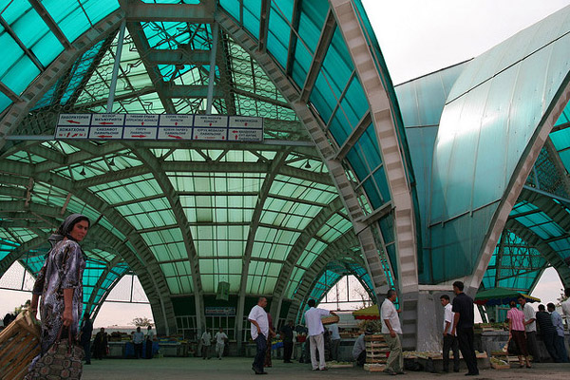
On Sundays and Thursdays, the always interesting Andijan bazaar bursts its banks and floods the surrounding streets in a deluge of haggling, repartee and insults. Trucks deposit mountains of melons into the epicentre while fringes are devoted to pigeon fanciers, carpenters, blacksmiths, brush selers, knife makers and skullcap embroideres.

Slide 6
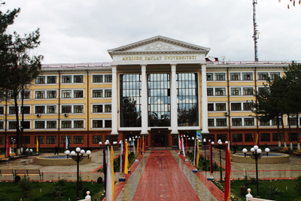
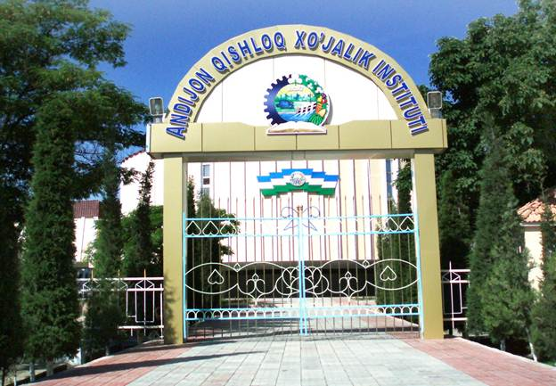
There are four higher education institutions in Andijan City. The Andijan Medical Institute is the largest of the four. The city is also home to four colleges, one academic lyceum, 21 vocational schools, 47 secondary schools, three music and art schools, nine sports schools, and 86 kindergartens.

Slide 7
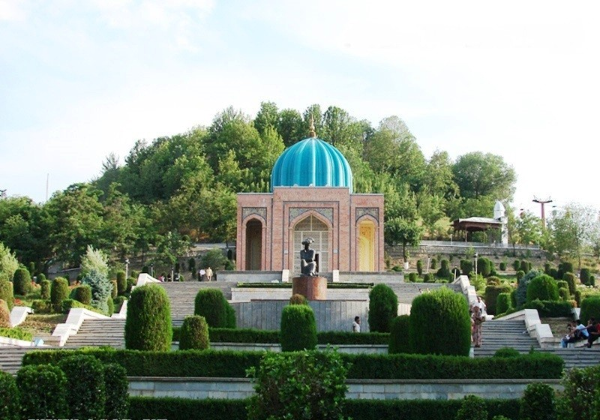
Andijan has a bunch of small museums, the most important of which is the Babur Literary Museum. Babur studied in a madrasa on this site, and design of the heavily rebuilt structure harks back to its original use. A rose garden retreat from the pounding anvils of Bazernaya Street craftsmen is this former madrasah given over to one of its former pupils. Destroyed after Babur’s departure, it was restored in the 18th century first for use as Andijan’s town hall, and then as the Ark Ichy, resedence of the city’s ruling family. It opened as a museum in 1990.

Slide 8
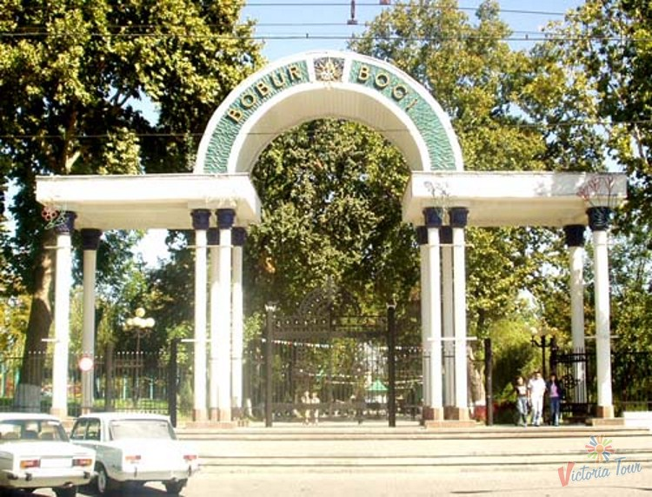
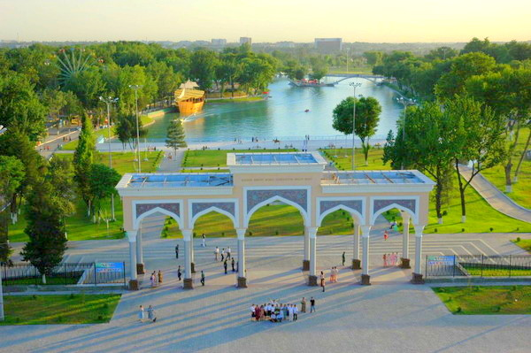
Babur Memorial Park
Seven km southeast of Andijan is this park, opened in 1993 to celebrate the arrival of earth brought from Babur’s Kabul grave.
Navoi Park
This green haven of trees and boating ponds lies east of Babur Square, where a horseback Babur knocked Lenin off his podium and where the May 2005 protets turned most bloody.

