Slide 1
Samarkand branch of Tashkent University of Information Technologies
Self study work
Theme: Famous people of Uzbekistan

Slide 2
Plan:
1. Famous people of Uzbekistan.
2. Amir Temur.
3. Alisher Navoi.
4. Mirzo Ulugbek.
5. Zakhiriddin Mukhammed Bobur.
6. Abu-Rayhon Beruniy.
7. Al-Khorezmiy Mukhammed Bin Mussah.

Slide 3
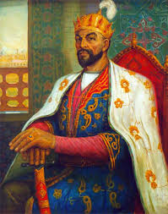
Amir Temur
Amir Temur Amir Temur was born in 9th April 1336 in Hodja Ilgor village (Yakkabag) near Kesh (Shahrisabz). His father emir Muhammad Taragaj was from notable family of a Turkic sort barlas. He was the influential person and had the big authority in Movarounnahr. His ancestors took a worthy place in the ranks of Chigatay ulus palace elite and made up their family tree from legendary turkis marshal Alan – Kuva, and their possessions were around Kesh and Nefes. Temur’s father emir Taragay constantly participated in kurultyas of chugatay beks, convened by the ulus khan on coast of the river Il. In 1355 he marries the daughter of emir Dzhaku – of Turmush aga barlas. The Supreme emir of Mivarounnahr Kazagan, having convinced of advantages of Amir Temur., in the same year has given him his grand daughter Uldzhaj Turkan aga as wife.. They together opposed Mongols. In 1356 A. Temur had two sons – Djahangri and Omar Shajh. The economic situation in Movarounnahr at the end of 13th – first half of 14th century worsened from day to day.

Slide 4
Khan of Mongolia Togluk Temur who without resistance in 1360 has reached up to Kashkadarya has taken advantage of it. Amir Temur has arrived to him for service. But when Togluk Temur has appointed as the governor of Movarounnahr his son Iljas Hodzha, Amir Temur has not wished to serve this prince and having agreed with governor Balh emir Husejnom Amir Temur has entered persistent struggle against Mongols. At that time Samarkand was dominated by sarbadors – "hunged men", who were also struggling against Mongols. The name of this national movement has arisen from slogans of its participants «Struggle for freedom, or a head on the gallows». In 1370 Amir Temur on kurultay in Balh has been proclaimed by the Supreme as emir of Turan. And the marriage with daughter of Chingizs Saray Mulk Hanum allowed Amir Temur to add to his name a honorable title "kuragan", i.e. « the son-in-law of khan ». The primary objective of Amir Temur became overcoming dissociation and association of separate possession into a uniform state. As a Capital of this state he has chosen Samarkand where has urgently started erection of city defensive walls, citadels and a palace. He has put in pawn a new Samarkand, near to ruins of ancient capital of Sogdiana (modern Afrasiab). Having united and subordinated the lands between Amu Darya and Syr-Darya, and also Fergana and Shash viloyat, Amir Temur began aggressive campaigns. For 35 years had lasted board of A.Temur ( 1370 - 1405 ) in Central Asia. He has created enormous empire from Indus and Ganges up to Syr-Darya and Zarafshan, from Tien-Shan up to Bosporus, he had lead the most part of his life in campaigns. During the campaign to China, in 1405 Amir Temur died in Ortrar. During the life time of Amir Temur a special composition about the government known under the name «Temur Code» has been written. It is a valuable historical source of the Middle Ages, consisting of two parts.

Slide 5
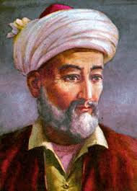
Alisher Navoiy
Alisher Navoiy An ingenious poet and the thinker, the musician and the artist, the teacher and the scientist, a great statesman and one of the most cultural persons of his time. Alisher Navoi was the conventional head of the cultural life of Herat, the patron of numerous representatives of sciences, arts and cultures. “Due to Alisher many people have received literary and art education and talent strengthening and there is no any other patron and the tutor of people as Alisher”. - wrote Babur Alisher Navoi was born on February 9, 1441 in the city of Herat, the capital of Huroson State. From the childhood Alisher was interested in reading the works of classics of Persian-Tadjik literature: Saadi, Attar and others. According to Navoiy himself, such poets as Lutfi Sheikh Kemal Turbati have directed, assessed the verses written by him. Navoiy studied at the most educated people of that time, took part in their highly intellectual and deeply instructive conversations. Having no family, no children, no successors, the poet spent a significant part of his huge wealth for charity. He has constructed a lot of educational institutions, hospitals, a caravan– sheds, channels, bridges and roads. In Herat Navoi maintained the closest relations with the great Tadjik poet and thinker Abdurrahman Dzhami ( 1414 - 1492 ) who was his closest friend, the adherent, the teacher and the spiritual instructor.

Slide 6
Friendship of Navoiy and Dzhami remain in a history for ever as a bright symbol of friendship between Uzbeks and Tadjiks. By the time when Navoiy became one of the outstanding persons in Hurasan, having received a honorable post at a court yard, he already had reputation of the masterly master of a verse. The generosity of his talent was that the poet has captured all versions of lyrical works created by peoples of the Muslim East during many centuries. Gazals and kitas, tarjibans and rubai– in what genre would not act Nаvоiy, he proved everywhere with shine boundless opportunities of his talent and skill. Many known representatives of the literature, art and science of second half 15 – the beginning of 16 century, as a token of deep respect for Alisher Navoi and in gratitude for his support, devoted to him their works. The image of this versatile and talented person historically is not separable from the broad audience of his contemporaries, friends, admirers and direct pupils – poets and musicians, scientists and architects, calligraphers and artists, historians and the writers, who defined their activity as cultural blossoming of Herat « epoch of Nabvoiy ». Navoi has died On January 3, 1501 in Herat. All Herat saw off to last way its favorite poet and the wise figure. The mourning concerning Alisher Navoi’s death lasted during the whole year - so great was the love to the person who has devoted all talent and skills to the people who had been indefinitely loved by him. Alisher Navoi’s literary heritage is very huge. In it we find the set of fine poems, epic products, scientifically – philosophical pathes, literary researches, biographies of scientists, poets, philosophers, works on a history, on linguistics. On the top of poetic creativity of Navoi is creation of "Hamsa" – a cycle from five poems: « Confusion just », « Layli and Madjnun», « Farhad and Shirin», « About seven wanderers », « Wall of Iskandar». The spiritual heritage of the remarkable son of Uzbeks presently gets to be known internationally, it becomes the property of everyone, to whom the interests of the world, friendship and nations unity is valuable.

Slide 7
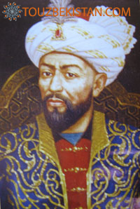
Mirzo Ulug`bek
ULUGBEK Ulugbek (Mukhammad Ta-ragai) was born in 1394 in Sulta-nia. His father was great Timur's son Shahruh, his mother was Gavharshodbegim, the grand daughter of the Naiman's padishah Kutlugkhan. Ulugbek was brought up by his grandmother Saraimulkhanum. When he was 15 years old he became the ruler of Samarkand. When he was 17 he became the ruler of Mavara-Un-Nahr and he ruled the state during 40 years. Really it was very difficult for him to combine the state affairs with science and Ulugbek realized it only after his defeat with Barakhan. The great scientist liked to devote himself to science, but he needed the throne too; if he were not a sultan amir how could he build the expensive observatory, erect madrasahs, pay hundreds of scientists for their work? Ulugbek's mother Gavharshodbegim didn't want her son to be the scientist and she said that the world was not governed by science, by books, but only by power. Her son Ulugbek became a great scientist, he tried to send human ideas to the stars and to get the new knowledge from so long distance. He compiled the catalogue of stars which is very popular even today. When Ulugbek was the ruler of Samarkand, it became the centre of art and science. Mavara-un- nahr became powerful and strong. But a lot of his amirs didn't support his policy and they tried to plunder the state treasure, to begin the war between cousins and between the father and the son. Historians of Ulugbek’s time wrote that Ulugbek had been beheaded by his own son’s decree at a spot some ten or twelve miles from Samarkand

Slide 8
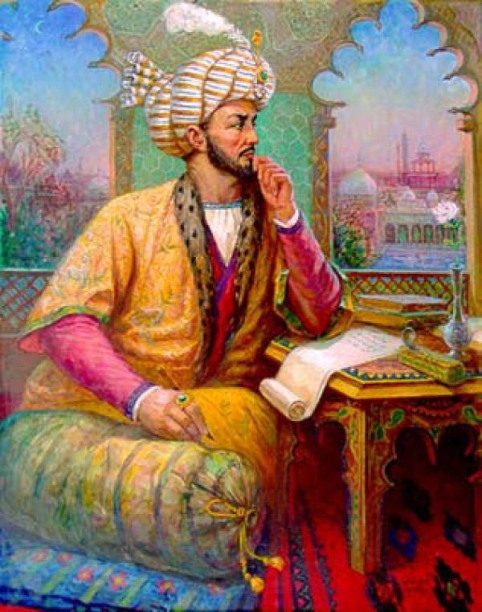
Zahiriddin Muhammad Bobur
BOBUR Bobur, Zahir-Iddin ( 1483-1530 founder of the great Mogul (Muhgul) dynasty in India; was a Barlos Turk descended on the male side from Timur and on the female side from Chagatai Khan (a son of Chinggiz Khan, the great mongol scourge of Asia. In 1494 at the age of eleven, he succeeded his father, Sultan Mirza, as a ruler of the small state of Fergana. From 1494 to 1504 he vainly endeavoured to maintain his position in Fergana; But he was expelled by more powerful neighbours and eventually sought refuge in the mountain fortresses of Kabul, which became his headquarters until 1525 . Political conditions in India contributed to the success of his plans. Babur's defeats and victories are recorded in his frank and intimate memoirs (the Bobur-noma). Bobur records in his famous memoirs that his chief ambition was to recover the vast territories which had once formed part of Timur's mighty Empire. At his death in 1530 he controlled the greater part of Northern India. But Bobur is famous not only as the founder of Mogul dynasty and the general, he was a prominent poet of 15-16 centuries, the creator of Bobur-noma, historical work of a world importance. His memoirs are of great influence for our knowledge about India of those days.

Slide 9
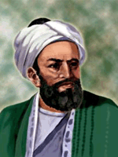
Abu-Rayhon Beruniy
Abu-Rayhon Beruniy Abu-Rayhon Beruniy– a remarkable scientist, amazing with variety of his scientific interests, boldness of idea, the author of more than 150 works devoted to actual issues of natural sciences, philosophy, history, philology, great encyclopedic thinker, the humanist of the Middle Ages epoch. Outlook of Abu-Rayhon Beruniy was formed at the end of X – the beginning of XI century in Central Asia. He was born on 2 Zu-ul-hidja in 362 (on September 4, 973 A.D.) in suburb of Kyat, former feudal capital of Khorezm. On the native land he has received good education and from a youth began his scientific activity. Due to political events in Khoresm Beruniy left the native land and approximately in between 998-1004 lived in Gurgan, at southeast coast of Caspian Sea. At this time he has done a great work – «Monuments of the past generations ». In about 1005 Beruniy came back to Khorezm, where at a court yard of the Khorezm king Abu Abbas Mamun ibn Mamun ( 1009-1017 ) occupied honorable position.

Slide 10
In 1017 Mahmud Gaznavi ( 998-1034 ) has subordinated to himself Khoresm, and in the same year Beruniy together with some other scientists had been compelled to follow the conqueror to Hansa where he stayed up to the end of his life. Despite the unfavorable conditions for him in the capital Mahmuda, Beruniy was entirely given to scientific researches. Together with the army of sultan, Beruniy had several times visited India. He has taken advantage of the trips for studying this country and as a result, by 4030 he had written an outstanding composition on India. Earlier, in 1025 Beruniy finished "Geodesy". To sultan Masud ( 1030-1041 ), the receiver Mahmud, Beruniy has devoted his main work on mathematics and astronomy – «Masudov kanon». At government of the subsequent sultan – Masud ( 1041 - 1048 ) – Беруни written the big work on mineralogy, and at the end of a life – "Saydan". He died in Gazna 2 Radjab 440 . (on December 11, 1048 ).

Slide 11
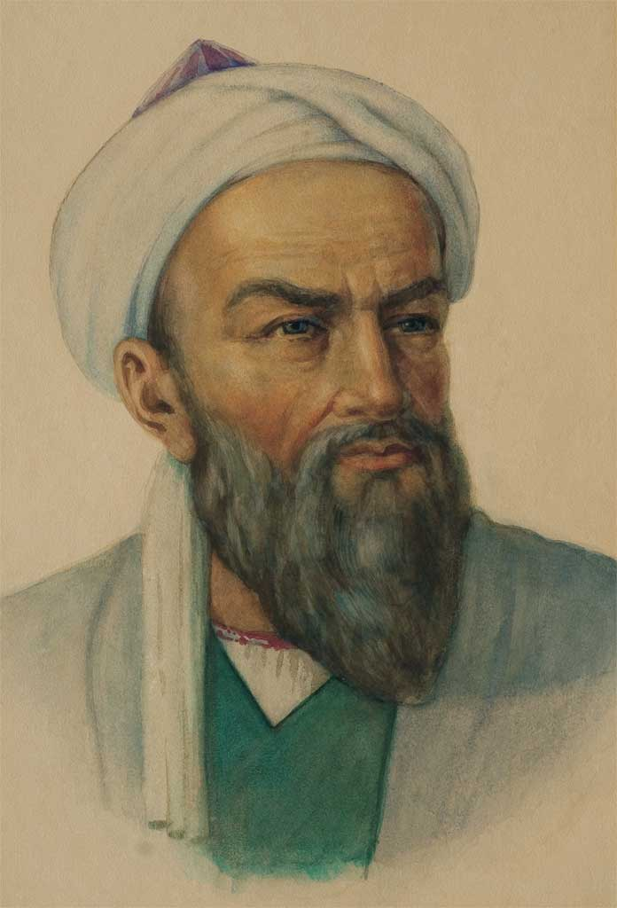
Al-Khorezmi Muhammed Bin - Mussa (783 - 850)
Al-Khorezmi Muhammed Bin - Mussa ( 783 - 850 ) Nickname Al – Khorezmi specifies his native land – the Central Asian state Khoresm (nowadays territory of Uzbekistan), Bin Mussa – "son of Mussa", and one of nicknames of the scientist – Al – Madjusi– speaks about his origin from a sort of magicians (on – Arabic "madjus"). It shows also, that one of sources of knowledge of Mohammed Al – Хорезми was science prior to Islamic Central Asia the keepers of which were magicians. He managed in Baghdad the library of wisdom House of some sort of the Baghdad academy at caliphate of Al – Mamun. There were the arithmetic treatise « The Book about the Indian account », the algebraic treatise « The Brief book about calculation of algebra and almukabal», astronomical tables and a geographical path. Both mathematical treatises have been translated into Latin language of medieval Europe and served for a long time as the basic textbooks on mathematics. Nickname Al-Khorezmi in the modified form has turned to a nominal word "algorithm" and all over again meant all system of decimal item arithmetics. Subsequently this term has received a wider sense in mathematics as a rule performing operations in certain order. Thus, actions « Al - Djebr» and "Al-Mukabala" have replaced with themselves transfer of nowadays-used equation members from one part of the equation into another and reduction of similar members.

Slide 12
He could solve any quadratic equation by his general rule (finding positive roots). If Greeks had geometrical solutions the method Al – Khorezmi was almost algebraic. This is an enormous step forward in comparison with geometrical algebra of Greeks. In the arithmetic treatise Al – Khorezmi basically followed the Indian samples, and from him the Europeans have got familiar with the Indian methods of recording the numbers, that is the use of zero and location of figures values. The algebraic path differed from both works, that of Indian mathematicians, and Greeks. It can be believed, that in this book Al – Khorezmi followed local traditions and own results. If the majority of Greeks did not see necessity to apply the scientific knowledge to practical needs, the main desire of Al – Khorezmi was to place a science to serve to humankind and to adapt it for the practical purposes. In Algebra Al – Khorezmi has a section about trade and commercial transactions, with problems on a threefold Rule. Thus, for the first time in a history of mathematics in the treatise of Al – Khorezmi have appeared the general rules of solving the quadratic equations .

Slide 13
Literatures.
1. www.Google.com//Famouspeopleofuzb//.
2. www.yandex.ru
3. Translate.google.ru

