Slide 1
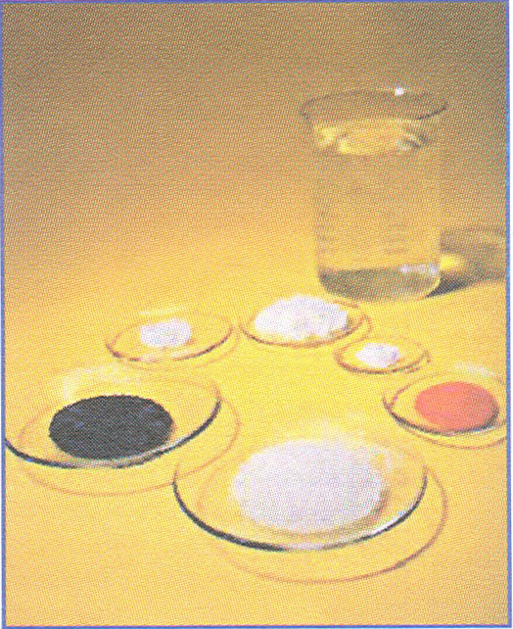
Theme:the phosphate (fosfor)
Prosurer(tayyorladi):Mukhammadova Makhliyo
Verifyst(tekshirdi): Ahadov Mamur

Slide 2
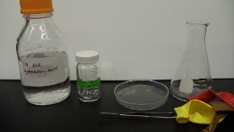
Inorganik chemical is a salt of phosphorit acid.
(anorganik kimyoda fosfat kislotaning tuzlarida uchraydi)

Slide 3
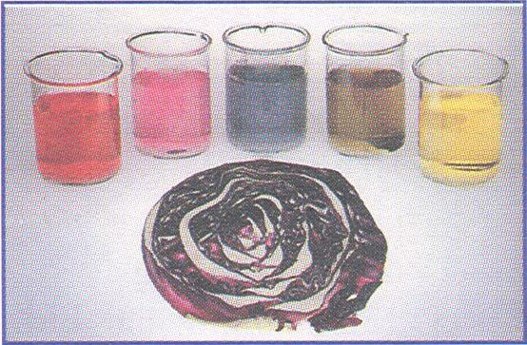
In organic chemistry a phosphate or orgonophosphate,is an ester of phosporic acid
(organik kimyoda fosfat yoki organikfosfor va fosfat kislotalar tarkibida bo’lADI)

Slide 4
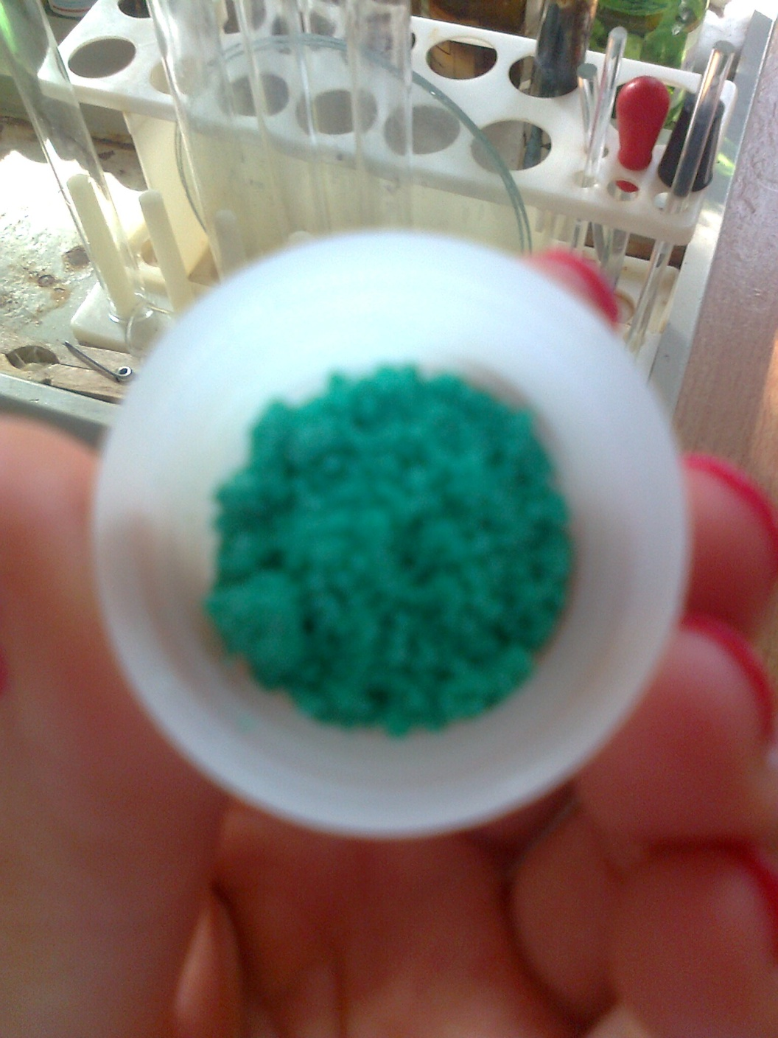
ORGANIK PHOSPHATES ARE IMPORTANT IN BIOCHISTRY BIOGEOCHEMISTRY ECOLOGY
(ORGANIK FOSFOR BIOLOGIK VA BIOKIMYOVIY JARAYON VA EKALOGUYADA MUHIM AHAMIYATGA EGA)

Slide 5
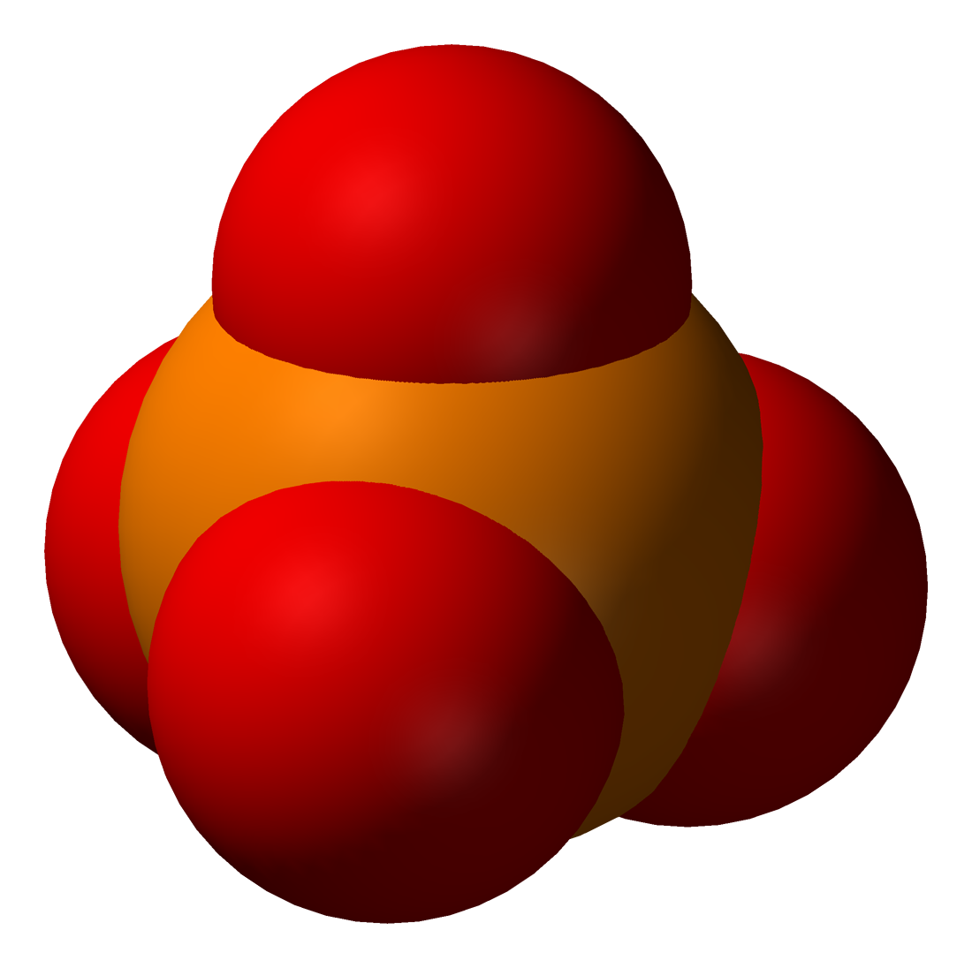
This is the structural formula of the phosphate.
Bu fosforning struktura shakli hisoblanadi.

Slide 6
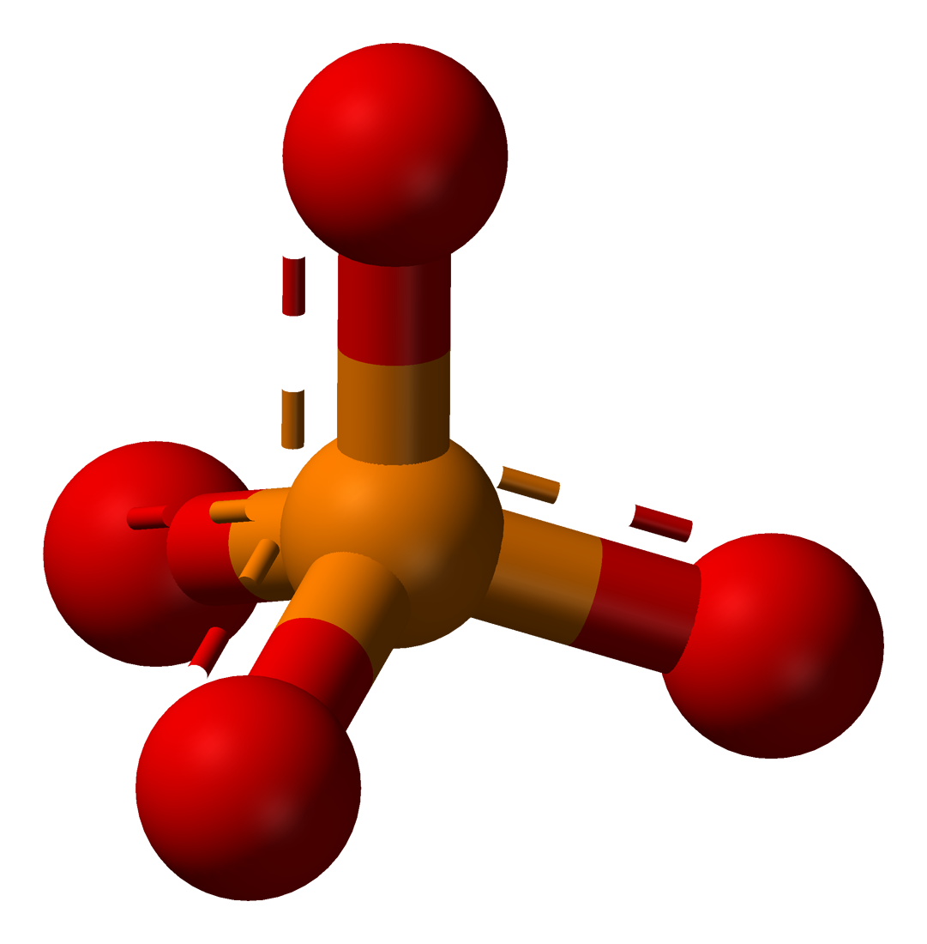
Phosphate atoms a tethraedral arrangament.
(Fosforning shakli tetraedrik shaklda tartibga solingan)
This is phosphate atoms
(bu fosforning molekulasi)

Slide 7
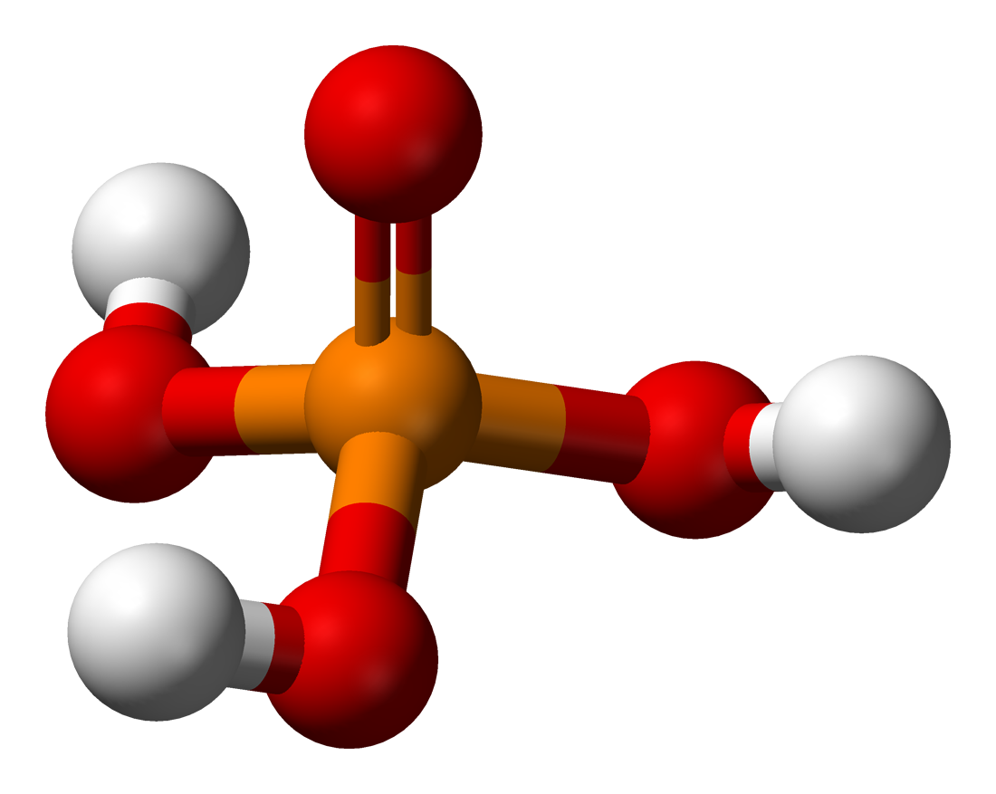
There is atoms a phospharic acid
(h₃po₄)
(fosfat kislota atomi)

Slide 8
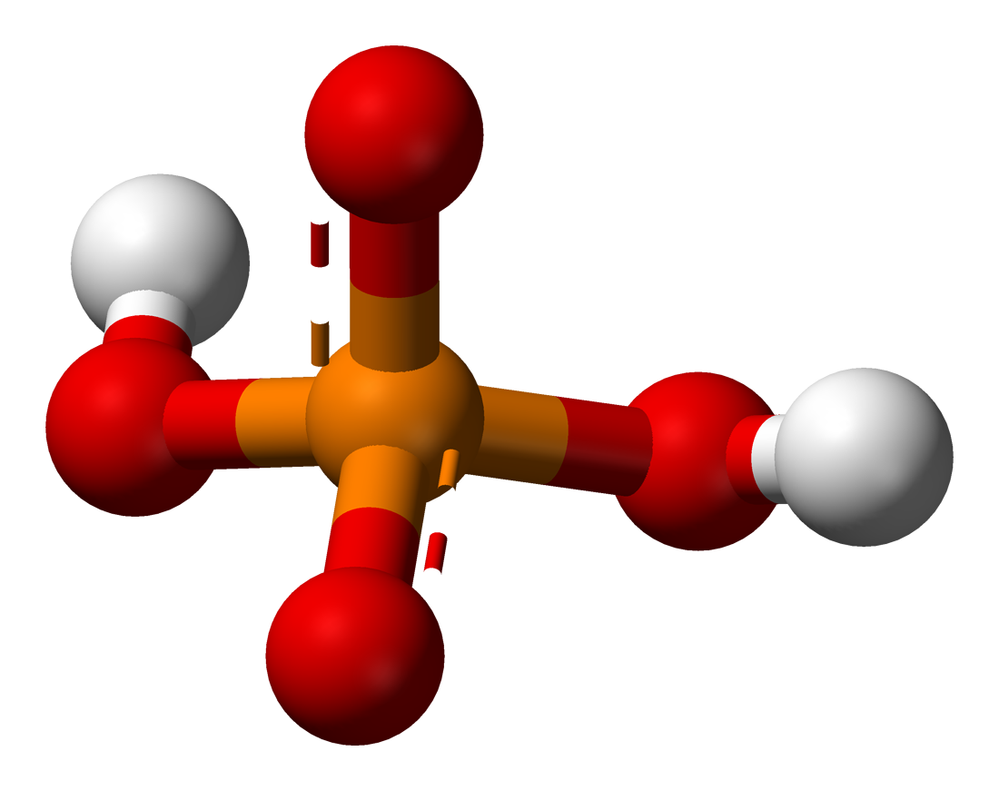
There is atoms a dihydrogen phosphate h₂po₄ bu digidrofasfat kislotaning atomi

Slide 9
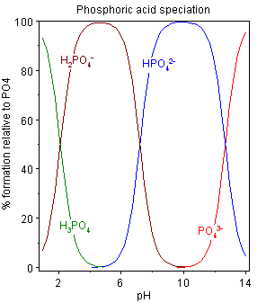
The specification diagram abtained using these pk values shows three acids
(ushbu maxsus diagrammada 3ta kislotaning ph qiymati aks ettirilgan)

Slide 10
See also(e’tiboringizni qarating)
The ion a phurophosphate –P2O7
Poluphosphate

