Slide 1
Mavzu: O’tkir burchak sinusi, kosinusi, tangensi va kotangensi
9-sinflar uchun Geometriya fanidan 30-maktab o’qituvchisi Ochilov Zafarning bir soatlik dars ishlanmasi

Slide 2
Dars maqsadi:
A) Ta’limiy; O’quvchilarga oddiy trigonometrik tushunchalar haqida bilim berish;
B) Tarbiyaviy: O’quvchilarni fikrlash dunyosini kengaytirish, ularni mehnatsevarlik fazilatlarini rivojlantirish
Dars turi: Yangi bilimni o’zlashtirish
Dars jihozi: Kompyuter, ko’rgazmali qurollar
Dars uslubi: Noan’anaviy

Slide 3
Darsning borishi
Tashkiliy qism
Uyga vazifani so’rash. Aqliy hujum
Uchburchaklar burchagiga ko’ra necha xil bo’ladi?
Qanday uchburchak to’g’ri burchakli uchburchak deyiladi?
Pifagor teoremasini ayting.
III. Yangi mavzu bayoni

Slide 4

To’g’ri burchakli uchburchakning o’tkir burchak sinusi
B
$\sin{∝ = \frac{BC}{AB}}$
C
A
α
Ta’rif: To’g’ri burchakli uchburchak o’tkir (α) burchagining sinusi deb, α burchak qarshisidagi katet (BC)ning gipotenuza (AB) ga nisbatiga aytiladi.
Sin α “Sinus alfa”

Slide 5

To’g’ri burchakli uchburchakning o’tkir burchak kosinusi
B
$\cos{∝ = \frac{AC}{AB}}$
C
A
α
Ta’rif: To’g’ri burchakli uchburchak (α) burchagining kosinusi deb, α burchak qarshisidagi katet (AC)ning gipotenuza (AB) ga nisbatiga aytiladi.
Cos α “Kosinus alfa”

Slide 6

To’g’ri burchakli uchburchakning o’tkir burchak tangensi
B
$\operatorname{tg}{∝ = \frac{BC}{AC}}$
C
A
α
Ta’rif: To’g’ri burchakli uchburchak (α) burchagining tangensi deb, α burchak qarshisidagi katet (BC)ning yopishgan katet (AC)ga nisbatiga aytiladi.
tg α “Tangens alfa”

Slide 7

To’g’ri burchakli uchburchakning o’tkir burchak kotangensi
B
$\operatorname{ctg}{∝ = \frac{AC}{BC}}$
C
A
α
Ta’rif: To’g’ri burchakli uchburchak (α) burchagining kotangensi deb, α burchakka yopishgan katet (AC)ning qarshisidagi katet (BC)ga nisbatiga aytiladi.
Ctg α “Kotangens alfa”

Slide 8
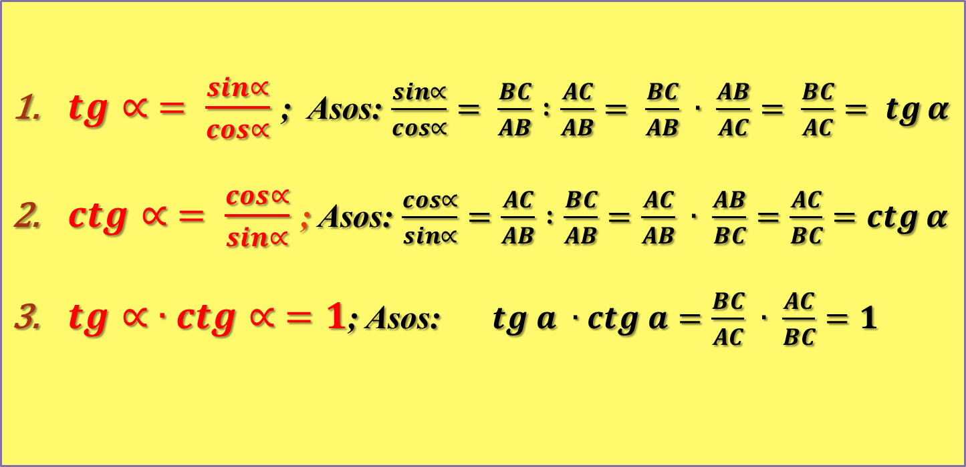
Yuqoridagi ta’riflardan kelib chiqadigan formulalar
$\operatorname{tg}{∝ = \frac{\sin{∝}}{\cos{∝}}}$ ; Asos: $\frac{\sin{∝}}{\cos{∝}}= \frac{BC}{AB} :\frac{AC}{AB}= \frac{BC}{AB} ∙ \frac{AB}{AC}= \frac{BC}{AC}= \operatorname{tg}{α}$
$\operatorname{ctg}{∝ = \frac{\cos{∝}}{\sin{∝}}}$ ; Asos: $\frac{\cos{∝}}{\sin{∝}}=\frac{AC}{AB} :\frac{BC}{AB}=\frac{AC}{AB} ∙ \frac{AB}{BC}=\frac{AC}{BC}=\operatorname{ctg}{α}$
$\operatorname{tg}{∝ ∙ctg∝ =1}$; Asos: $tg a ∙ctg a=\frac{BC}{AC} ∙ \frac{AC}{BC}=1$

Slide 9
To’g’ri burchakli uchburchak tomonlarining o’tkir burchakka nisbatan nomlanishi
gipotenuza
Qarshisidagi katet
α
Yopishgan katet

Slide 10
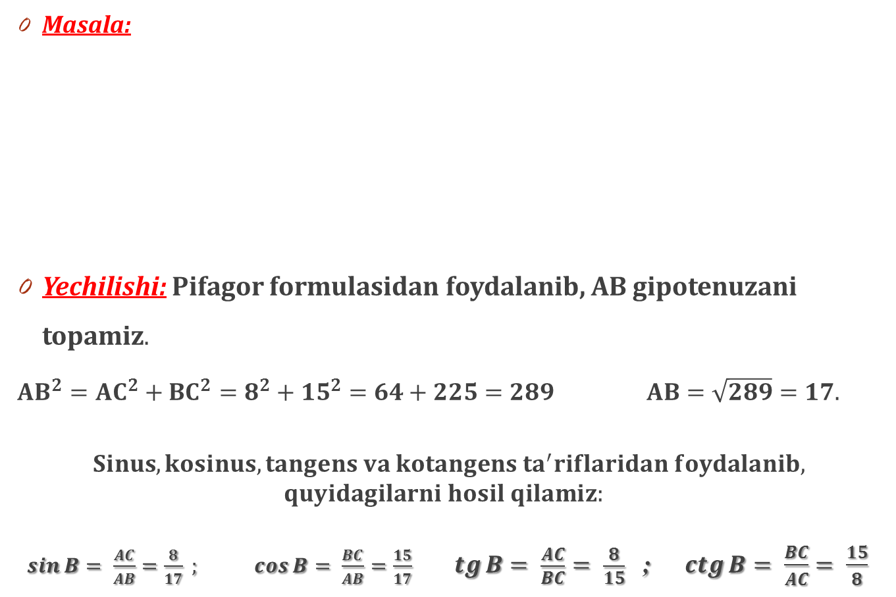
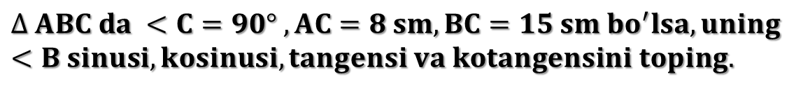
IV. Mustahkamlash
Masala:
Yechilishi: Pifagor formulasidan foydalanib, AB gipotenuzani topamiz.
${AB}^{2}={AC}^{2}+{BC}^{2}=8^{2}+{15}^{2}=64+225=289$ $AB=\sqrt{289}=17.$
$$Sinus, kosinus, tangens va kotangens ta^{′}riflaridan foydalanib,$$
$$quyidagilarni hosil qilamiz:$$
$\sin{B= \frac{AC}{AB}=\frac{8}{17} ;\cos{B= \frac{BC}{AB}=\frac{15}{17}}} \operatorname{tg}{B= \frac{AC}{BC}= \frac{8}{15}}$ ; $\operatorname{ctg}{B= \frac{BC}{AC}= \frac{15}{8}}$
$$∆ ABC da <C=90° , AC=8 sm, BC=15 sm bo^{′}lsa, uning<B sinusi, kosinusi, tangensi va kotangensini toping.$$
B
A
C

Slide 11

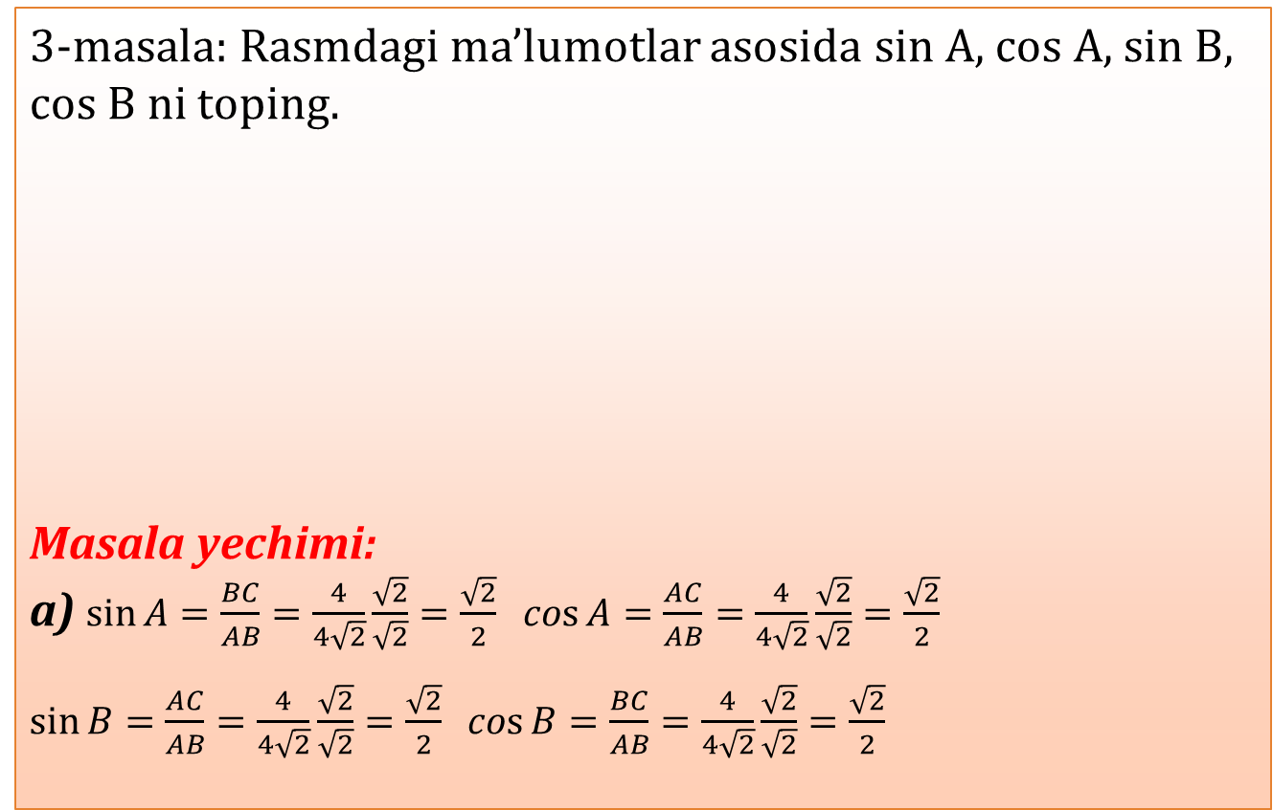
3-masala: Rasmdagi ma’lumotlar asosida sin A, cos A, sin B, cos B ni toping.
Masala yechimi:
a) $\sin{A=\frac{BC}{AB}=\frac{4}{4\sqrt{2}}\frac{\sqrt{2}}{\sqrt{2}}=\frac{\sqrt{2}}{2}}$ $\cos{A=\frac{AC}{AB}=\frac{4}{4\sqrt{2}}\frac{\sqrt{2}}{\sqrt{2}}=\frac{\sqrt{2}}{2}}$
$\sin{B=\frac{AC}{AB}=\frac{4}{4\sqrt{2}}\frac{\sqrt{2}}{\sqrt{2}}=\frac{\sqrt{2}}{2}}$ $\cos{B=\frac{BC}{AB}=\frac{4}{4\sqrt{2}}\frac{\sqrt{2}}{\sqrt{2}}=\frac{\sqrt{2}}{2}}$
A
A
A
63
C
4$\sqrt{2}$
25
4
7
16
C
65
C
B
B
B
a)
4
24
b)
d)

Slide 12
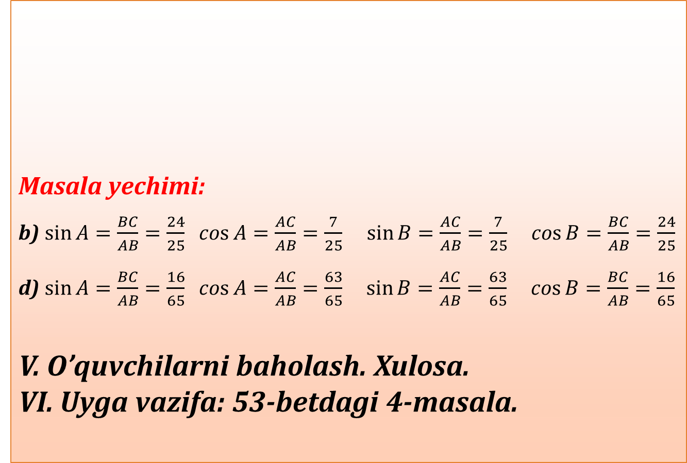
63
C
Masala yechimi:
b) $\sin{A=\frac{BC}{AB}=\frac{24}{25}}$ $\cos{A=\frac{AC}{AB}=\frac{7}{25}}$ $\sin{B=\frac{AC}{AB}=\frac{7}{25}}$ $\cos{B=\frac{BC}{AB}=\frac{24}{25}}$
d) $\sin{A=\frac{BC}{AB}=\frac{16}{65}}$ $\cos{A=\frac{AC}{AB}=\frac{63}{65}}$ $\sin{B=\frac{AC}{AB}=\frac{63}{65}}$ $\cos{B=\frac{BC}{AB}=\frac{16}{65}}$
V. O’quvchilarni baholash. Xulosa.
VI. Uyga vazifa: 53-betdagi 4-masala.
A
A
25
7
16
65
C
B
B
24
b)
d)

Slide 13
E’TIBORINGIZ UCHUN RAHMAT!!!

