Slide 1

THEME: PLANNING FOR FUTURE

Slide 2
PLAN OF THE LESSON
My future planning and dreams.
What is electrician doing?
New words of Electricity.
Modal verbs.

Slide 3
AIM OF THE LESSON
Educational: the student should know the rich vocabulary of the professions; they should use constructions of sentence and grammar material easily while acting out situations.

Slide 4


What is your future planning?

Slide 5

What is your dreams?

Slide 6
DO YOUR KNOW…….
What is electrician doing?
What are their closes?
What are their tools?

Slide 7



Arc flash helmet glovers

Slide 8
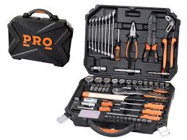
Tools [tu:l] ish asboblari

Slide 9
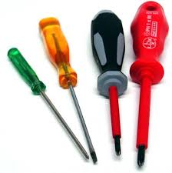
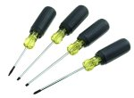

Screwdriver
Mini screwdriver
Phillips screwdriver

Slide 10



Pliers
Diagonal
Long Nose

Slide 11



Scissors tape measure electrical tape

Slide 12
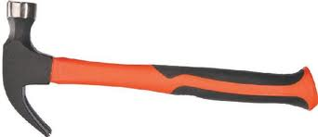


Electrician’s Hammer
Knife
Hatchet

Slide 13

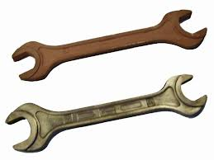

Adjustable wrench
Wrench
Hook

Slide 14
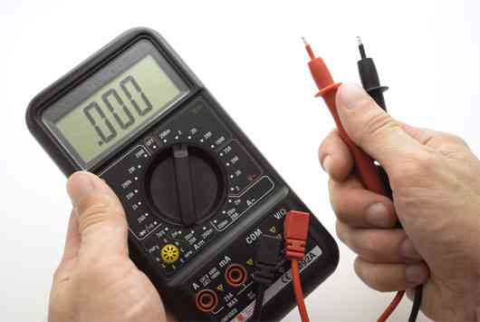
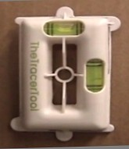
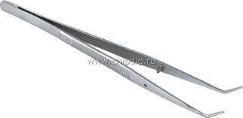
Multimeter
Tracer tool
Tweezers

Slide 15

Drill
(a)bit
(b)shank

Slide 16
Bolt-bolt
Nut-gayka
Washer-
shayba
Nail-mix
Screw -vint
(a) head-
bosh
(b) thread-
rezba

Slide 17



Switch
Outlet
Plug

Slide 18

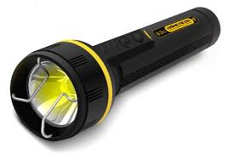
Electricity
Flashlight

Slide 19

Elektriklarga oid fe’llar
Tighten
Repair
Polish

Slide 20
Elektriklarga oid fe’llar
Wipe
Oil
Dust

Slide 21
Elektriklarga oid fe’llar
Change - almashtirmoq
Cut - kesmoq
Hit - urmoq

Slide 22
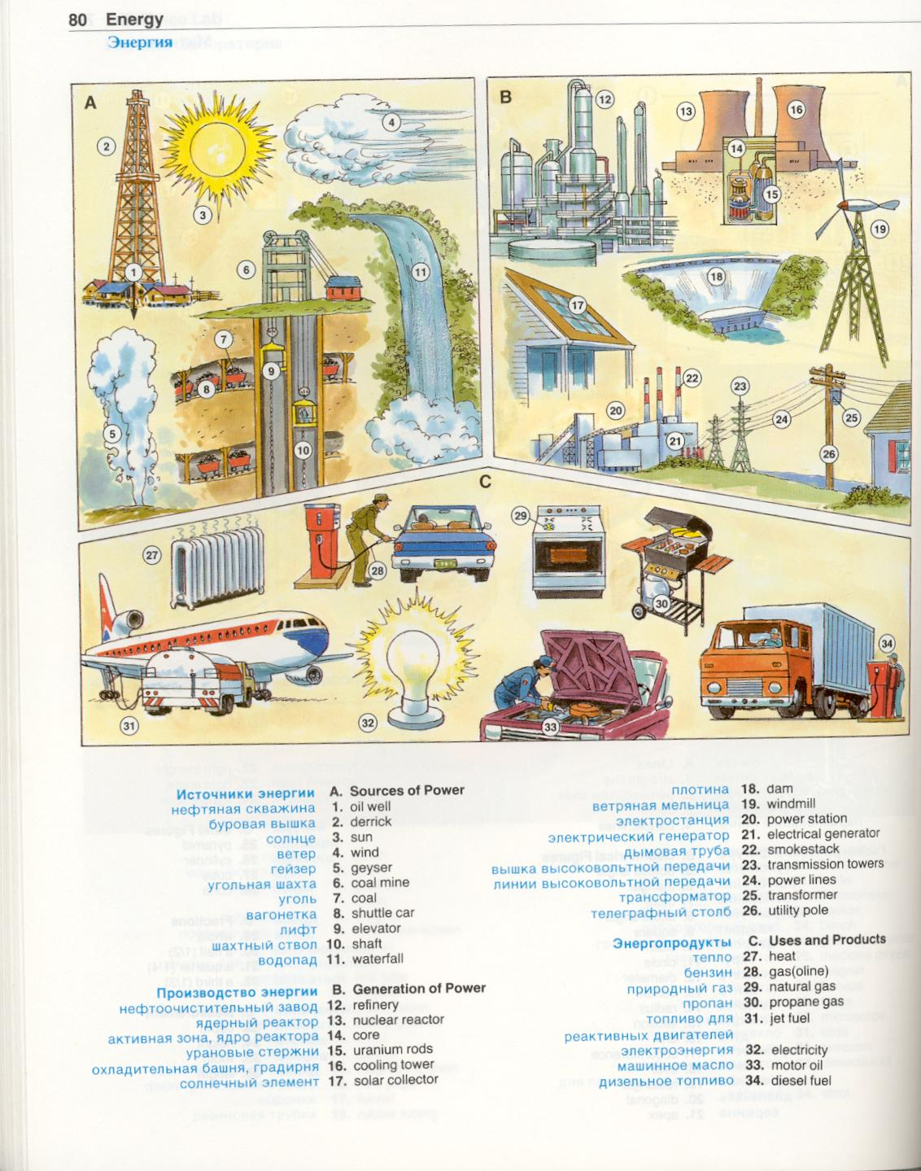
20 Power station-elektra stansiya
21 Electrical generator-elektro generator
22 Smokestack- tutun chiqadigan truba
23 Transmission tower – tok uzatish minorasi
24 Power lines - yuqori tok utkazuvci kabel
25 Transformer - trasformator
26 Pole - stolba

Slide 23
Modal verbs
Can – imkoniyatini, mumkinligini, qobiliyatini.
May - ruxsatni
Must – shart, kerak.

Slide 24
Modal verb CAN
I
can
swim
I
can
not
swim
can’t
Can
I
swim

Slide 25
Modal verb CAN
I can repair an iron.
Can you repair an iron?
Yes, I can. No, I can’t.
I can not (can’t) repair an iron.

Slide 26
Modal verb MAY
You
may
take
my book
.
?
.
.
May
I
come in
Yes,
you
may
No,
you
may not

Slide 27
Modal verb May
May I come in?
He may know her address.
He may not know her address.

Slide 28
Modal verb MUST
You must study hard.
You must not (mustn’t) late for the lesson.

Slide 29




MUST- “shart”
If you want to give somebody order, you can use “must”.
You must go in for sports to be healthy.
You must sleep enough to be healthy.
You must be friendly to be healthy.

Slide 30




MUST NOT - “shart emas”
If your order is negative, you can use “mustn’t”.
You mustn’t smoke to be healthy.
You mustn’t eat unhealthy food.
You mustn’t work on the computer too long to be healthy.

Slide 31

Fill in “can", “may”or “must”
I ______ run very fast.
They _____ understand English.
_____ I invite Nick to our house?
You ____ learn the new words.
_____ children play with scissors?
You ____ stop smoking.
Everybody ____ come to college in time.
He ____ stop eating much and he _____ lose weight.
He ____ translate this article without a dictionary.
You ____ take your exam.

Slide 32
Fill in “can", “may”or “must”
I can run very fast.
They can understand English.
May I invite Nick to our house?
You must learn the new words.
May children play with scissors?
You must stop smoking.
Everybody must come to college in time.
He must stop eating much and he must lose weight.
He can translate this article without a dictionary.
You must take your exam.

Slide 33

VERY GOOD!!!
Well done!!!

Slide 34
Make up sentences using “MODAL VERBS” and NEW WORDS.

Slide 35
MAKE UP “BBB” TABLE:
Bilardim | Bilib oldim | Bilishni xoxlayman

Slide 36
Conclusion of the lesson:
My future planning and dreams.
What is electrician doing?
New words of Electricity.
Modal verbs.

Slide 37
Your total score….
17-14 mark – “good”
21-18 mark – “very good”
25-22 mark – “excellent”
Students | 1- Appendix 0-5 | 2- Appendix 0-5 | 5- Appendix 0-5 | 6- Appendix 0-5 | 7- Appendix 0-5
Rustamov M
Ochilov M

Slide 38
HOMEWORK: To learn by hard new words.
Make up story “My future planning”.

Slide 39

The lesson is over.
GOOD BYE!!!

