Slide 1
TASHKENT IRIGATION AND MELIORATION INSTITUTE OF BUKHARA BRANCH
HYDROMELIORATION FACULTY
COURSE:1
NAME:F.FARRUX
BUKHARA-2016

Slide 2

HOW TO REACH IELTS

Slide 3

1. Some backround information about IELTS exam
2. The Process of holding for stages of IELTS
3. Some advices for taking high score on IELTS with the help of videos

Slide 4

The IELTS is divided into four parts: Listening, Reading, Writing and Speaking. In the Reading and Writing tests however, candidates have a choice between Academic and General Trainings. Most candidates who take the Academic versions of IELTS are intending to use the test to help them with their studies or for professional reasons.

Slide 5
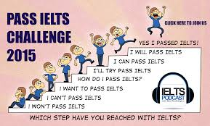
2016
HOW MUCH DOES IT TAKE?
The total test time is two hours 45 minutes.The first three parts – Listening, Reading and Writing – must be completed in one day.

Slide 6

Listening Test.
Time: aprox. 30 minutes.
The Listening test is in four sections and has forty questions, ten questions for each section. You will hear each listening text ONCE only. The test includes time for you to read the questions and to write your answers. At the end of the test you are allowed ten minutes to transfer your answers to an Answer sheet.

Slide 7
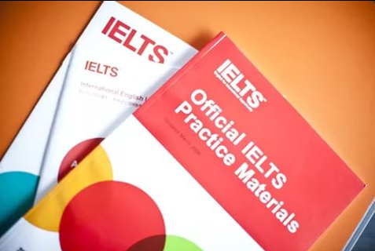
Reading Test.
Time: 60minutes.
The Reading test is divided into three sections. Each section contains a text. The texts are taken from newspapers or projects, descriptions of techniques, discussions of theories or issues.

Slide 8

Writing test.
Time: 60minutes.
There are two tasks in the writing test. Task 1 and task 2.
In task 1 you have to describe graphic date or process in at least 150 words. In task 2 you have to write an Essay in at least 250 words.

Slide 9
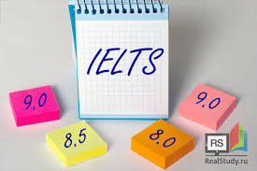
.Speaking test.
Time: 10-15 minutes
You will take the speaking test on your own with one examiner. The test consists of three parts. In part 1, the examiner introduces him/herself and asks you some questions about, for example your studies, home, interests, leisure time and habits. In part 2, the examiner asks you to speak about a topic for one-two minutes. You have one minute to propere. The examiner listens and tells you when the two minute are over. Then in part 3, the examiner asks you some questions which are related to the topic of the talk in part 2.

Slide 10
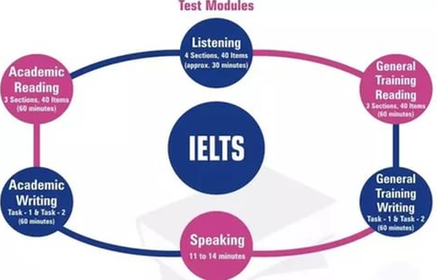

Slide 11
THANK YOU FOR YOUR ATTENTION

