Slide 1
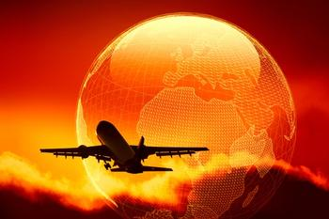
Nukus State Pedagogical Institute
Faculty of Foreign Languages
Theme: Air travel
Prepared by: Seytjanova L

Slide 2
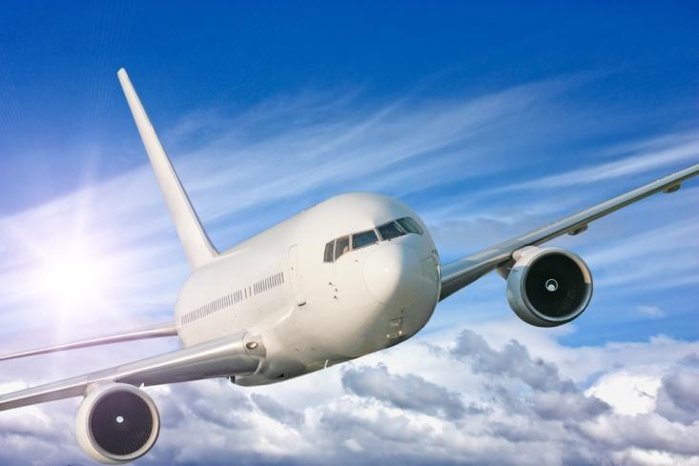
Air travel
It is a form of travel in vehicles such as airplanes, helicopters , hot air balloons, blimps, gliders, parachuting, or anything else that can sustain flight.

Slide 3
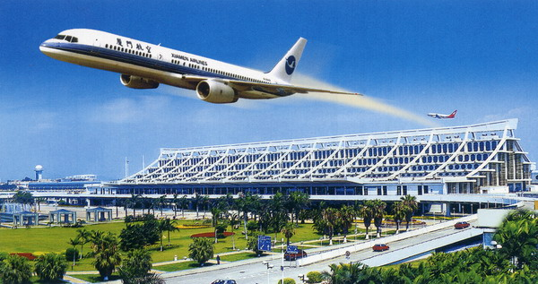
Airport- a place where aircraft regularly take off and land, with buildings for passengers to wait in.

Slide 4
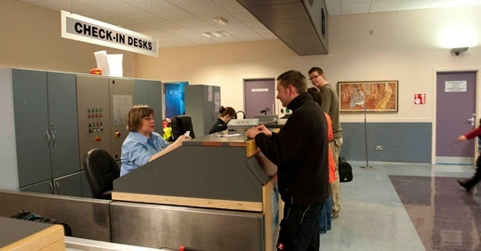
What do we do at airport?
Go to check-in desk- it`s a place at an airport, where you show your ticket and where people weigh your luggage;

Slide 5
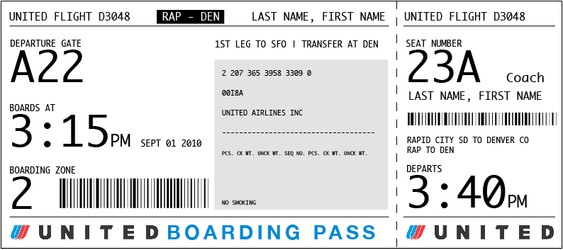
2. Then they give you a boarding card/boarding pass- it`s a card that a passenger must have to be allowed to enter an airplane;

Slide 6
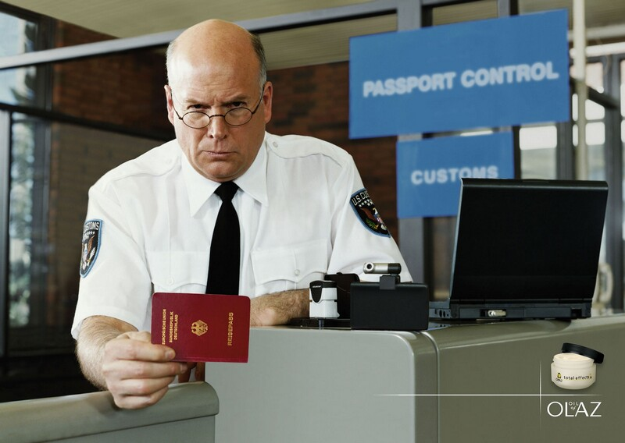
3. Then you go through the passport control- it`s a place where an official checks your passport;

Slide 7
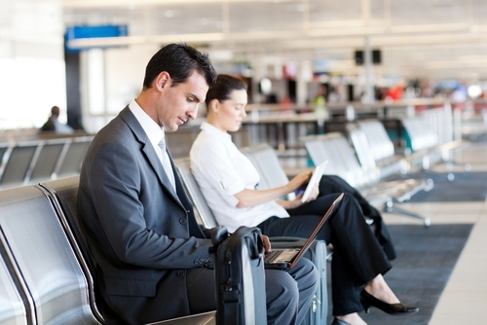
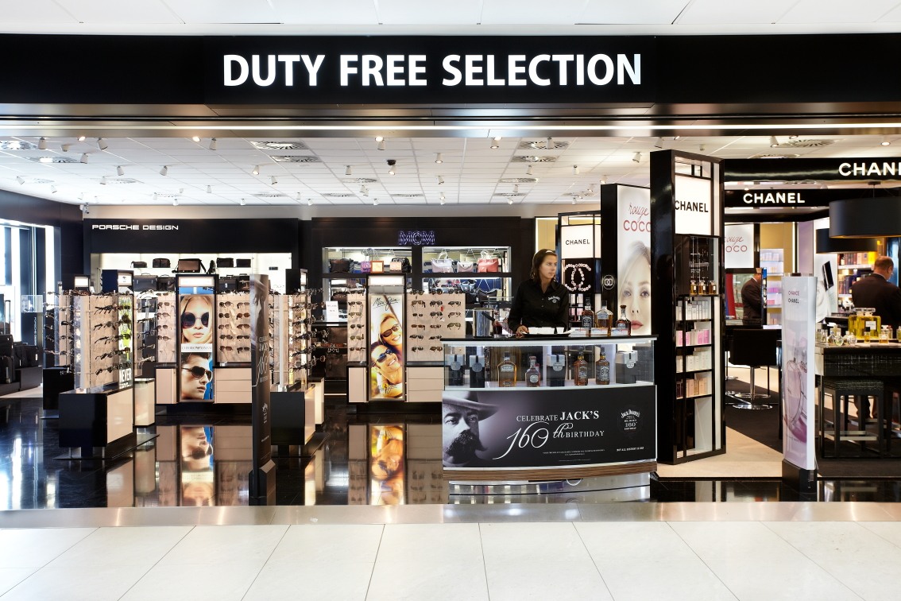
or you can go to the
duty-free- it`s a shop at an airport;
4. You go to departure lounge- it`s the area where passengers wait before getting onto airplane;

Slide 8
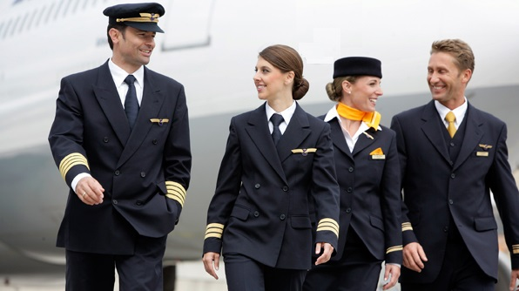
The flight
A captain- a pilot;
Steward and stewardess/cabin crew/flight attendants - people who look after the passengers;

Slide 9
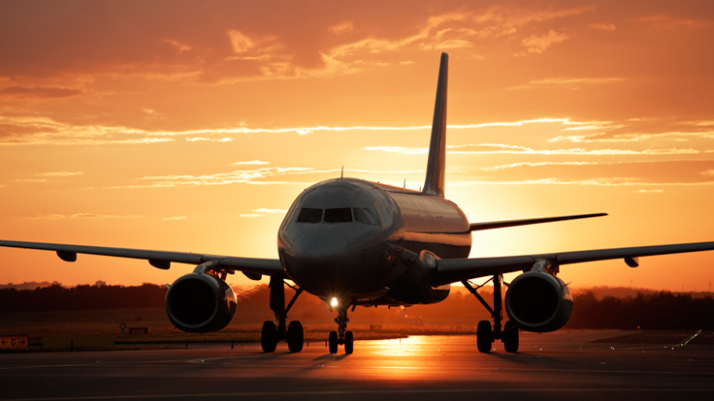
Arrival
Plane lands (arrives on the garden), you get off the plane and walk through the terminal building(where passengers arrive and depart).

Slide 10
Idioms
Board the plane- get on; When you board the plane, you find your seat.
Taxi- to move slowly; The plane taxis towards the runway.
Cruise- flying comfortably; I like cruising at an altitude(=height) of 10 000 metres.
Hire a car- rent a car; You can hire a car at most airports.

Slide 11
Exercises
Fill the gaps
Fasten your ….. Belt.
Buy thins in ……-free.
Check-in …… weighs your ...... .
Boarding or landing ...... .
Pass …….. the customs.

Slide 12
B. Organize the words into 3 groups: departures, flight, arrival.
Duty-free, stewardess, boarding card, cabin crew, terminal building, cruise, passport control, baggage reclaim, customs, captain, excess baggage, check-in desk, altitude.

Slide 13
Keys to the exercises
A.
Seat
Duty
Desk / luggage
Card
Through
B.
Departments: passport control, excess baggage, check-in desk, duty-free.
Flight: captain, stewardess, cabin crew, cruise, altitude.
Arrival: terminal building, baggage reclaim, customs.

Slide 14
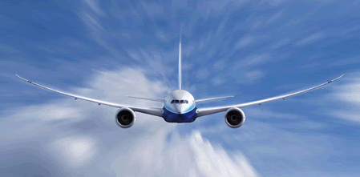
Have a nice flight!

