Slide 1
MURAKKAB ALGORITMLARNI DASTURLASH

Slide 2
1) y = xⁿ funksiyasini rekurent formula orqali hisoblash dasturini tuzing.
(x-ixtiyoriy son, n=10)
# include <iostream.h> void main ( ) { float x=2.56, y=1; for (int i=1; i<=10; i=i+1) y = y*x; cout <<“y=“<< y << endl; }

Slide 3
2) P = n!; (n=13)
# include <iostream.h> void main ( ) { int n; long p =1; f or ( n=1; n<=13; n++) p= p * n; cout << “N faktorial =“<<p<<endl; }

Slide 4
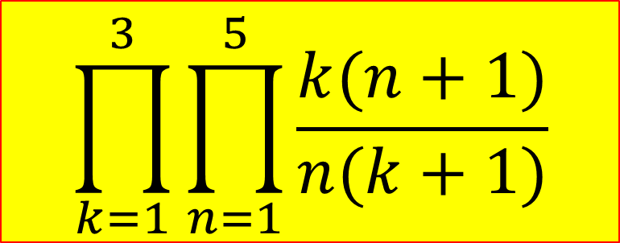
3) Quyidagi murakkab takrorlanuvchi algoritmning dasturini tuzamiz.

Slide 5

boshlash
P=1
K=1, 3
P1=1
N=1, 5
P=P*P1
P
tamom

Slide 6
(xatosini topamiz!!!!)
# include <iostream.h>
# include <math.h> void main ( )
{ float p, p1; for (int n=1; n<=3; n++) p1=1; for (int k=1; k<5; k++) p1=p1*k*(n+1)/n*(k+1); p=p*p1; cout<<“p=“<<p<<endl;
}

Slide 7
# include <iostream.h>
# include <math.h> void main ( )
{ float p=1, p1; for (int k=1; k<=3; k++)
{ p1=1; for (int n=1; n<=5; n++) p1=p1*k*(n+1)/(n*(k+1)); p=p*p1; } cout<<“p=“<<p<<endl;
}

Slide 8
4) Quyidagi yig’indini hisoblash uchun dastur tuzing: bu erda x € [π/5; 9π/5]; n=10

Slide 9
# include <iostream.h>
# include <math.h>
# include <conio.h> float pi=3.14; void main ( )
{ float a=pi/5, b=9*pi/5, h, x, s; clrscr( ); h=(b-a) / 10; x=a; cout.precision(3); while (x < = b)
{ s=0; for (int n=1; n<=10; n++) s = s + cos ( n*x ) / n; cout<<“x=“<< x << “s=“<< s << endl; x+=h; } getch ( ); }

Slide 10
5) Qadimiy masala
Bir cho’ponda 100 tanga pul bor edi. Cho’pon bozorga qo’ra mol olishga boribdi. Bozorda echki 0.5 tanga, qo’y 3 tanga, va sigir 10 tanga turadi. Chopon 100 tanga puliga 100 ta qo’ra mol olish kerak edu. U 100 tanga puliga nechta sigir, nechta qo’y va nechta echki oladi?

Slide 11
0Boshlash
Ii,j,k,S,Y
i=1; 100
j=1; 100
k=1; 100
S = i + j + k;
Y=i*10 + j*3 + k*0.5;
-
+
S=Y
i,j,k
tamom

Slide 12
#include <iostream.h>
#include <conio.h>
int main( )
{ clrscr( ); int i,j,k;
for(i=1; i<=100; i++)
for(j=1; j<=100; j++)
for(k=1; k<=100; k++)
{
if( i+j+k=100 && i*10+j*3+k*0.5=100 )
cout<<"Sigir:"<<i<<", Qo`y:"<<j<<, Echki:<<k<<endl
getch();
return 0;
} xatosini toping!!!

Slide 13
#include <iostream.h>
#include <conio.h>
int main( )
{ clrscr( ); int i, j, k;
for(i=1; i<=100; i++)
for(j=1; j<=100; j++)
for(k=1; k<=100; k++)
{
if(i+j+k==100 && i*10+j*3+k*0.5==100)
cout<<"Sigir:"<<i<<”Qo`y:"<<j<<“\tEchki:"<<k<<endl; }
getch();
return 0;
}

Slide 14
6) Qadimiy masala.
Boy bilan olim baxslashibdilar.
Olim boyga har kuni 100000 so’m
beradigan bo’libdi. Boy esa 1-kuni 1 tiyin
2-kuni 2 tiyin 3-kuni 4 tiyin 4-kuni 8 tiyin
va x.k pul beradigan bo’libdi.
Baxsda kim yutadi?

Slide 15
0Boshlash
Ii,k,S,Y
S=0; k=1;
i=1…30
S=S+k; k=k*2;
k=k/100; Y=30*100000;
-
+
S>Y
S
Y
tamom

Slide 16
#include <iostream.h>
#include <conio.h>
int main( )
{ int i, k, Y, S; S=0; k=1; clrscr( );
for (i=1; i<=30; i++)
{ S = S+k; k = k*2; }
S = S/100; Y = 30*100000;
cout<<"\t\t boy olimga "<<S<<"so'm pul beradi\n";
cout<<"\t\t olim boyga "<<Y<<"so'm pul beradi\n";
if ( Y>S )
cout<<"\t\t olim yutqazadi va boyga"<<Y-S<<
"so'm ko'p pul beradi!!!\n";
else cout<<"\t\t boy yutqazadi va olimga"<<S-Y<<
"so'm ko'p pul beradi!!!\n";
getch( ); return 0; }

Slide 17
Quyidagi yig’indini hisoblovchi dastur tuzing va uni berilgan funksiya bilan tekshiring, chunku bu yig’indi shu funksiyani ifodalovchi funksiyadir.

Slide 18
ushbu yig’indini hisoblash uchun dastur tuzing. Bu erda: x [0;1]; h=0,1; Bu yig’indi y=sin x funcsiyani ifodalaydi. Shuning uchun dasturda ularni aynan bir hil ekanligini hisobga olish kerak.

Slide 19
# include <iostream.h>
# include <conio.h>
# include <math.h> void main()
{ float x=0,y,s,p1,p2; int t,i; while(x<=1)
{ p1=x,p2=1,s=x;t=-1; for (i=1; i<=10; i++)
{p1=p1*x*x; p2=p2*(2*i+1)*2*i; s=s+t*p1/p2; t=-t;} y = sin(x); cout<<"x="<<x<<" y="<<y<<“ s="<<s<<endl; x=x+0.1;} getch(); }

