Slide 1
Uzavtosanoat
Holding Company
Operating in
Automotive Industry of Uzbekistan
Group:212
Maxammadov Bobur
Olimova Charos
Maxsudaliyeva Ra’no
Notes:
1

Slide 2
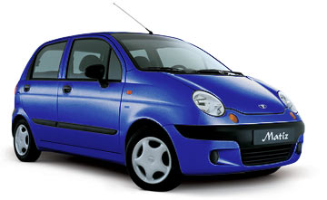
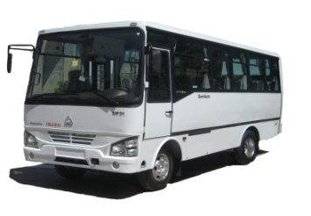
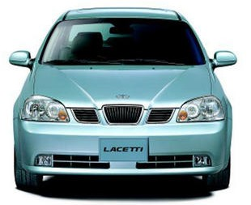
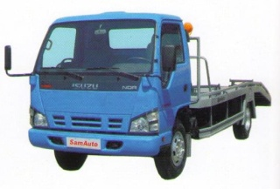
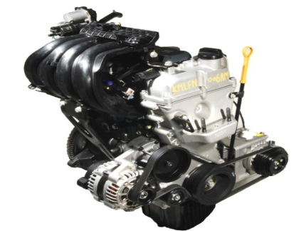
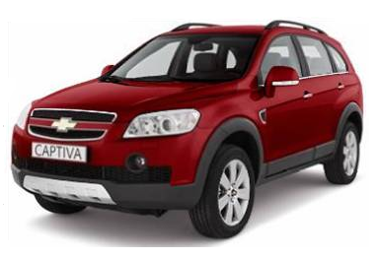
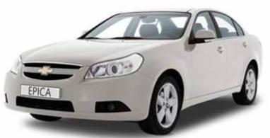
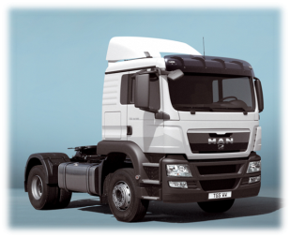
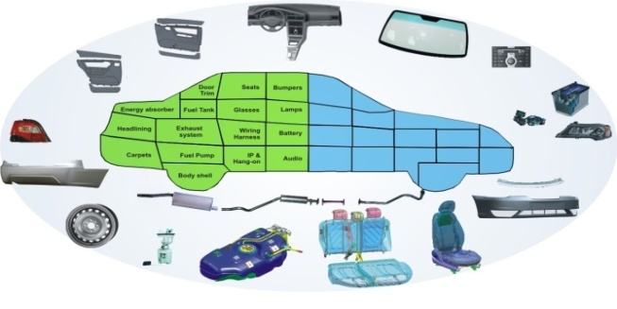
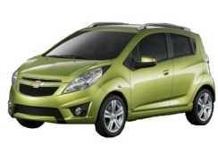
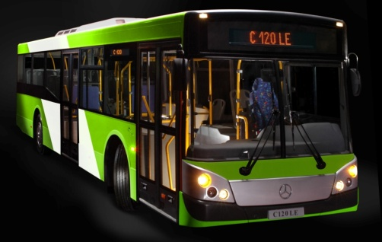
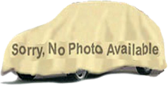
Company Structure
UZAVTOSANOAT
PASSENGER CARS
COMMERCIAL VEHICLES
COMPONENT PARTS
GENERAL MOTORS UZBEKISTAN
SAMAVTO
GM POWERTRAIN UZBEKISTAN
Engines BDOHC 1.2L & 1.5L.
MAN AUTO UZBEKISTAN
15 MAIN COMPONENTS SUPPLIERS
NEW GM GLOBAL PLATFORMS
MBCA
Spark
160 SMALL SUPPLIERS
GSV EM
2010
2012
ONGOING PROJECTS
Total employees - 17 thousand people Number of companies - 42
Notes:
2

Slide 3
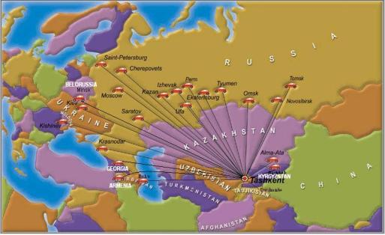
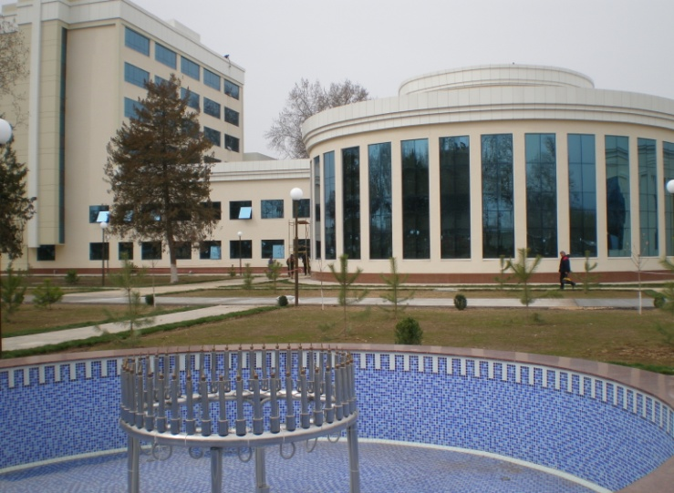
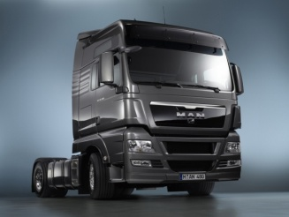
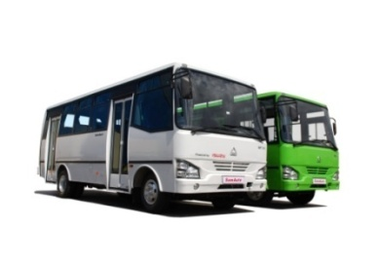
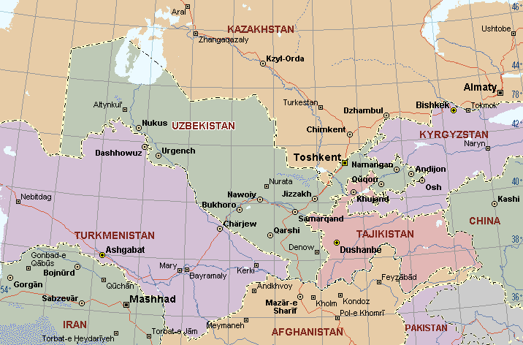
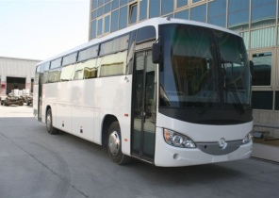

Specialized Divisions
Sales
Sales and service companies:
foreign dealers – 147
domestic dealers – 64.
Finance
“Uzavtosanoat Leasing”
Leasing sales of commercial vehicles
Education & Training
Turin Polytechnic University
CIS
UZBEKISTAN
Bank “Asaka” (17 % share)
Project financing
Trade financing
Banking services
College in Samarqand city
College in Andijan region
Notes:
3

Slide 4

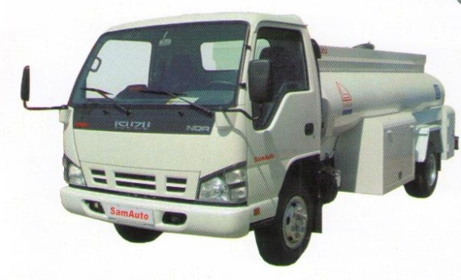
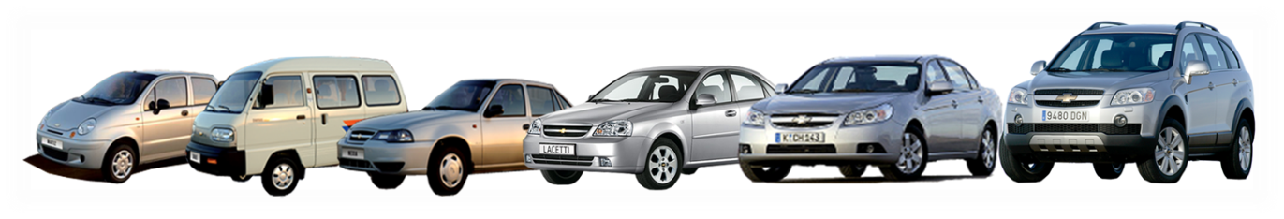
Sales volumes
GM Uzbekistan
SamAuto
In units
270 000
In units
3300
230 000
240 000
3000
218 000
2100
2300
FORECAST
FORECAST
Notes:
4

Slide 5
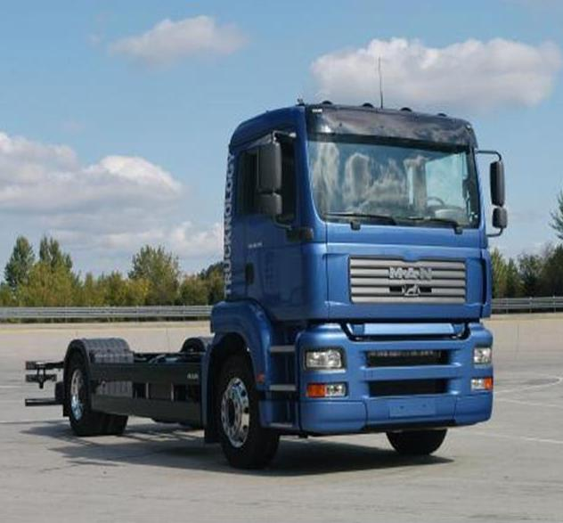
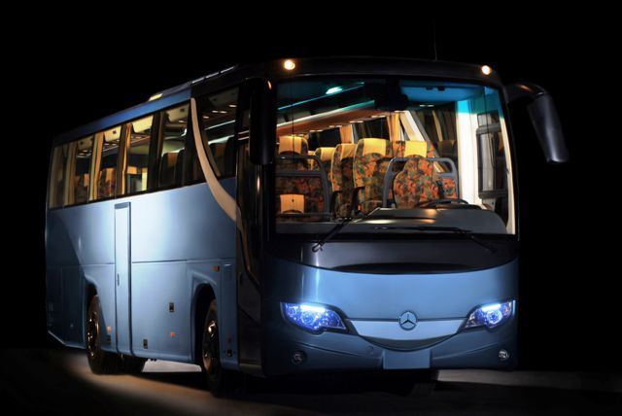
Sales volumes
MAN Auto Uzbekistan
Manufacturing Buses Central Asia
In units
Sales volumes forecast
In units
Sales forecast *
FORECAST
Start of production – 2010
* Start of production – 2011
Notes:
5

Slide 6
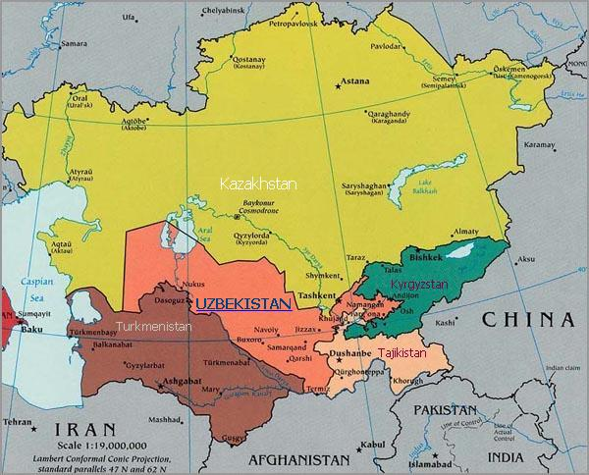
Investment advantages
REPUBLIC OF UZBEKISTAN
FACTORS OF SUCCESS
Free Trade Agreement (FTA)
300 mln. people
11 CIS countries
«OPEN DOOR» Policy
Favorable Investment Climate
System Privileges & Advantages
Government support for automotive
industry
Tax benefits for investors in
automobile sector

Slide 7
Strategic development of automotive industry
Development stages of automobile business
Added value
Number of countries
Import of finished automobiles
SKD Production
Full production cycle CKD
Machinery technologies
R&D
Fundamental science
License and Know-How import
Intensification of localization
Tools and equipment production
Automobiles and components
design
Know-How
Component parts production
Uzbek automotive industry

Slide 8





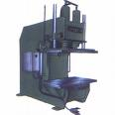

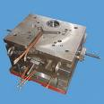



Priority directions of global cooperation
Alliances with global players in
automobile business including OEMs &
components manufacturers
Attracting of modern high technologies
Manufacture of Tools & Equipment
Education, training and experience
exchange
Development of R&D and Engineering

Slide 9
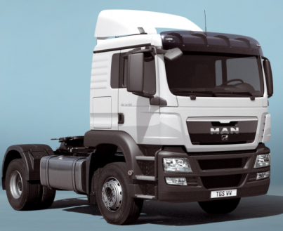
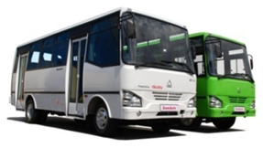


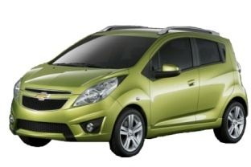

Uzavtosanoat development directions
Passenger Cars
General Motors
Heavy Duty Trucks
MAN
Medium Buses &
Trucks
Large Capacity Buses
Daimler
Integration into Global GM System
(Manufacture, Quality, Engineering)
Construction of new industrial complex together with MAN
Product portfolio diversification
Start and stable operation of a new plant
Development of the model range on the base of new GM Global Platforms
Volume increase and superstructure localization
Sales volume increase
Body parts and other components localization
localization including PWT and PWT components
Localization of components
Localization of components

Slide 10
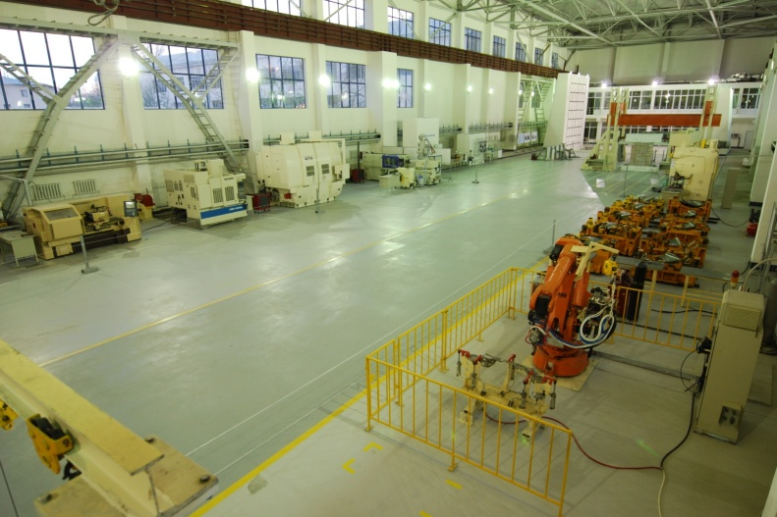
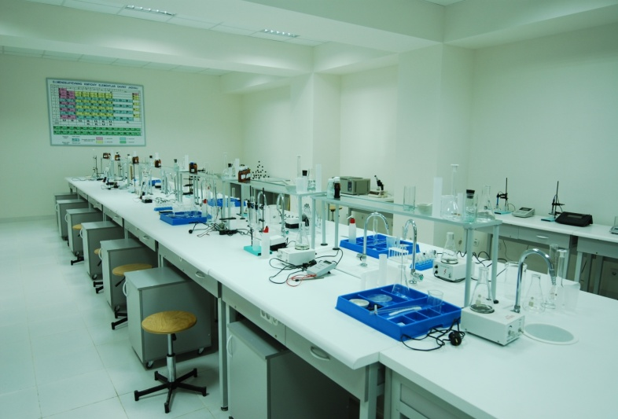
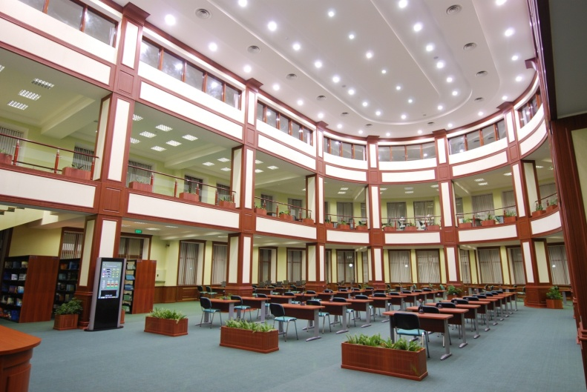
Turin Polytechnic University in Tashkent
Branch of Turin Polytechnic University in Tashkent was founded in 2009 in accordance with Resolution of the President of Uzbekistan
The University can host 1200 students a year by following directions:
Mechanical Engineering
Energy
Industrial Engineering/Design
Information Technology

Slide 11
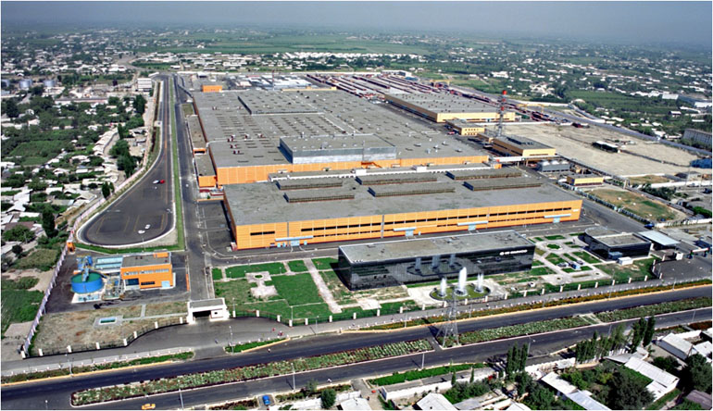
CSC “General Motors Uzbekistan”
Founders | Uzavtosanoat, General Motors
Authorized fund | 75% - Uzavtosanoat 25% - GM
Establishment | March 2008
Start | March 1996 (CJSC «UzDAEWOOAuto»)
Location | Asaka, Andijan Region
Total area | 720,000 m²
Area of buildings | 180,000 m²
Products | Damas, Nexia, Matiz, Lacetti, Captiva, Epica, Spark (M300)
Personnel | 7000 people

Slide 12
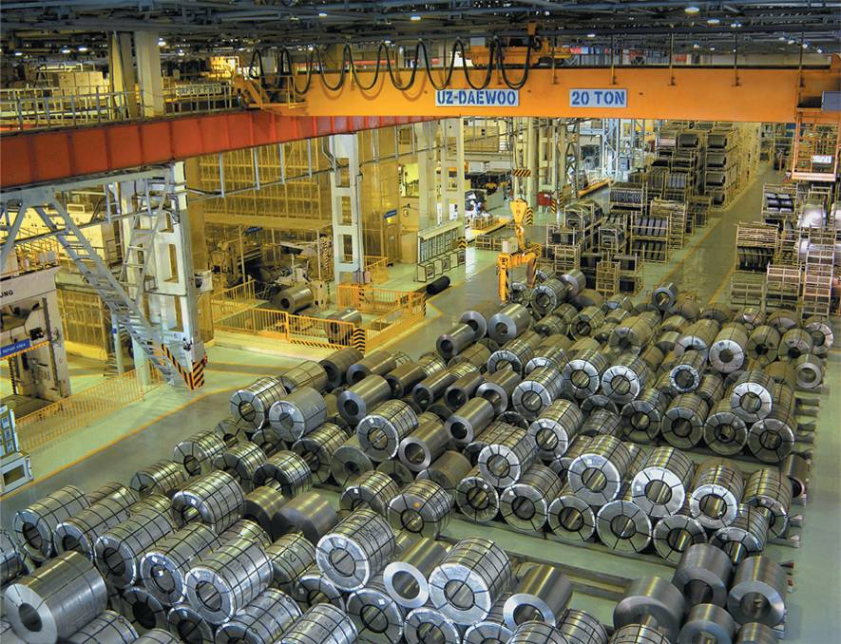
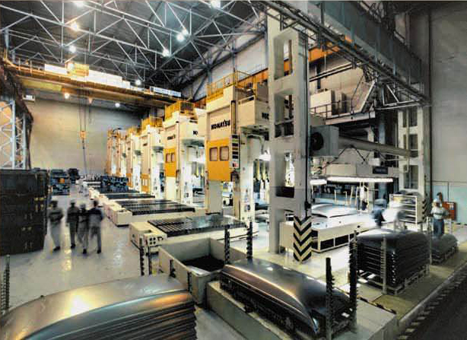
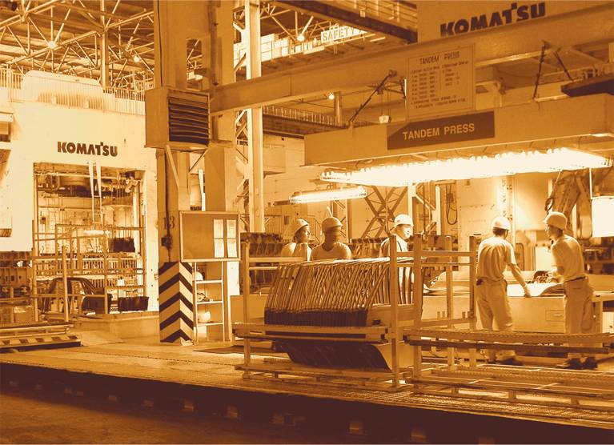
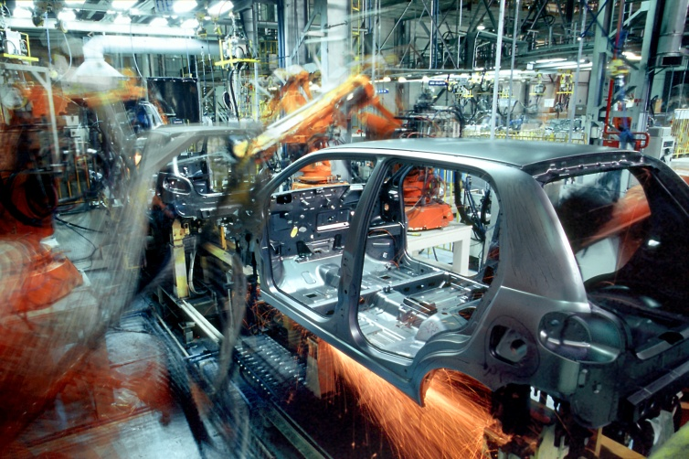
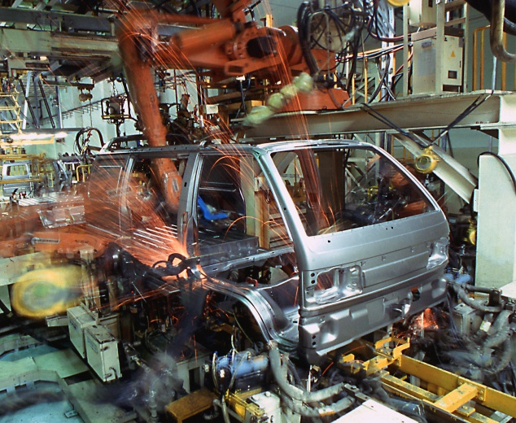
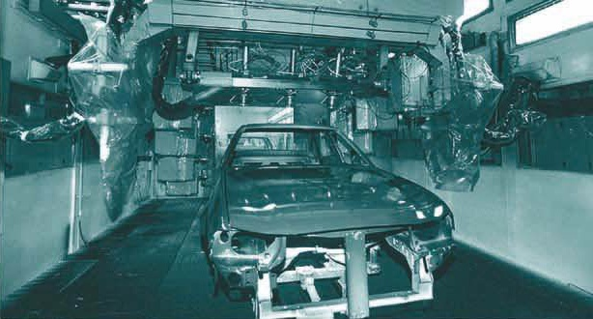
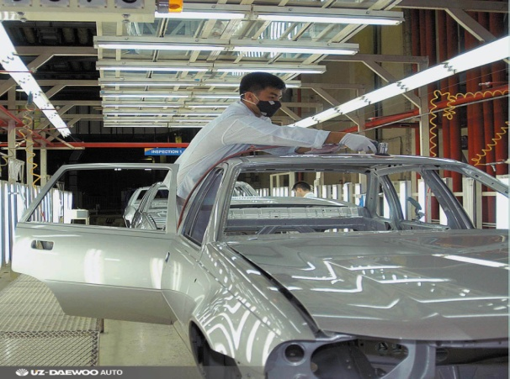
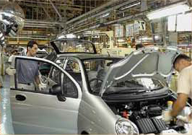
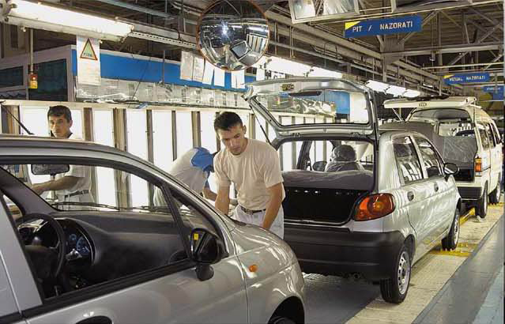
CSC “General Motors Uzbekistan”

Slide 13

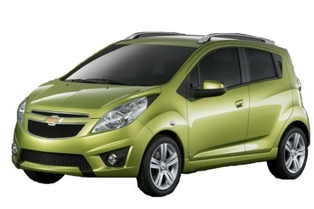
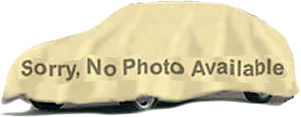
GM Uzbekistan products
Existing:
Matiz / Damas / Nexia / Lacetti / Epica / Captiva
New models:
Spark (M300) / GSV EM
2010
2012

Slide 14
GM Uzbekistan sales network
Export sales
network
CIS – 94 cities,
182 dealers.
Domestic Dealers
network
includes
64 dealers in all regions
of Uzbekistan

Slide 15
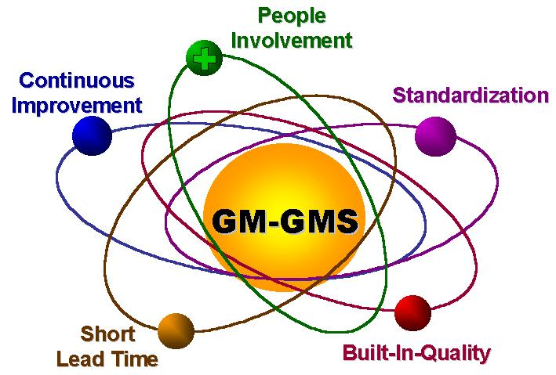
GM Global Manufacturing Systems
GOOD PROCESSES GOOD RESULTS
Vision/
Mission
Safety
People
Quality
Responsiveness
Cost
Environment
GMS
Goals & Metrics (Results)
Lean Principles
(Process)
Standardization
Built-In-Quality
Short Lead Time
Continuous Improvement Company
People Involvement Company

Slide 16
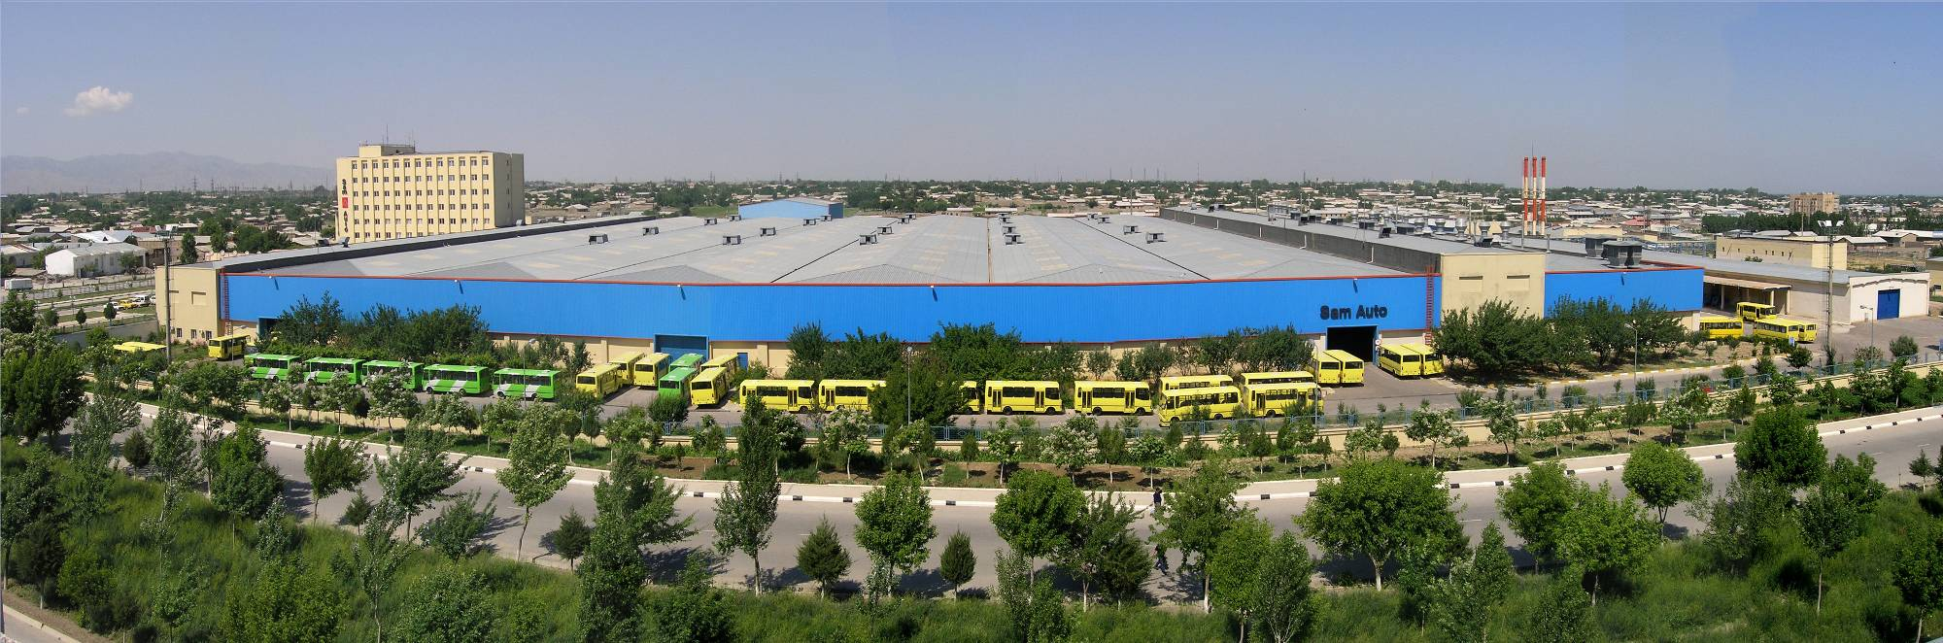
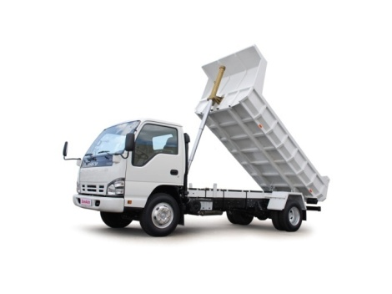

Samarkand Automobile Factory (SAF)
Founders | Uzavtosanoat, Asaka Bank, Itochu corporation
Authorized fund | 66% - Uzavtosanoat 26% - Asaka Bank 8% - Itochu Corporation
Establishment | November 6, 1996
Start | March 16, 1999
Location | Samarkand city
Total area | 126,000 m²
Area of buildings | 31,000 m²
Products | Buses, Truck & Commercial vehicles
Personnel | 800 people

Slide 17

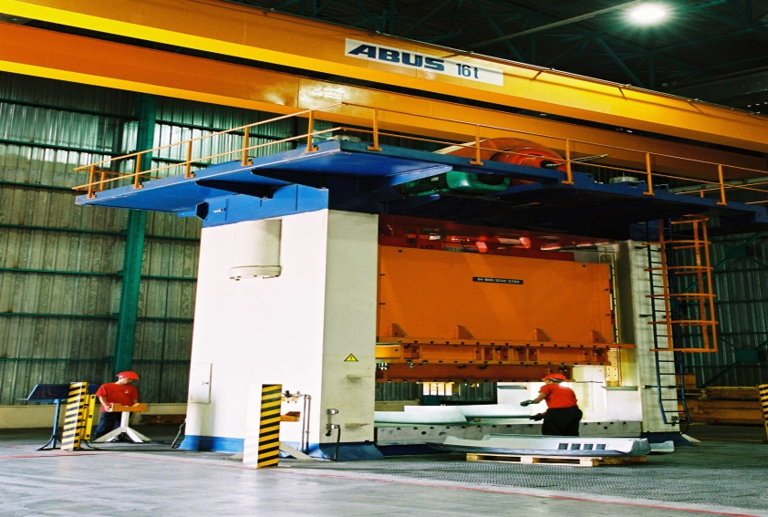
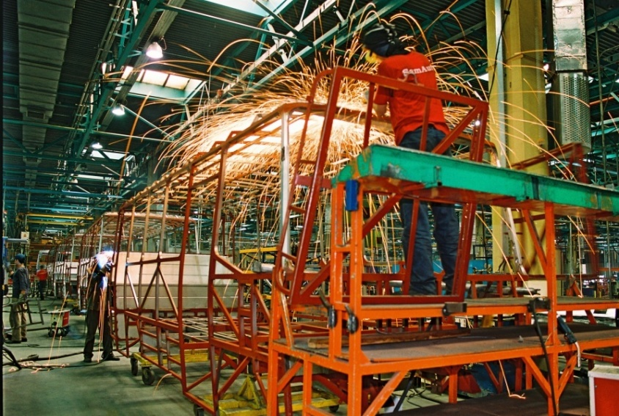
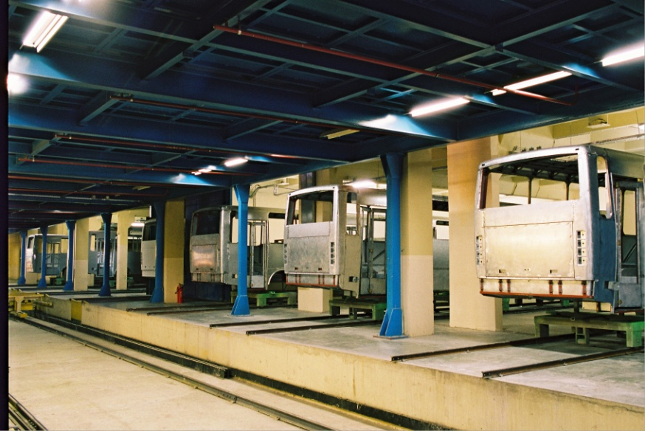
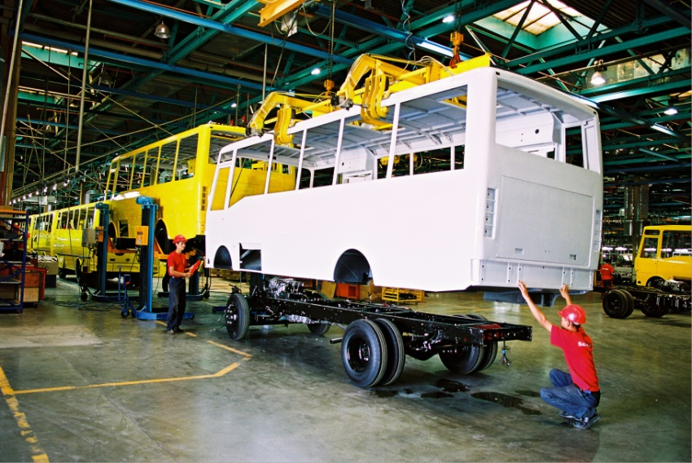

PRODUCTION

Slide 18





OUR PRODUCTS
SAZ NP 37/21 CITY BUS LE 60 WATER CARRIER-FLUSHER
GARBAGE TRUCK CHERRY PICKER TELESCOPIC BOARD TILT

Slide 19


GM Powertrain Uzbekistan
Authorized fund | Uzavtosanoat 48% General Motors 52%
Year of foundation | 2008
Start of production | November 2011
Location | Tashkent
Total area | 400 thous.sq.m
Products | Engines BDOHC 1.2L & 1.5L.
Personnel | 1200 people

Slide 20



JV MAN Auto Uzbekistan
Authorized fund | Uzavtosanoat 51% MAN Nutzfahrzeuge AG 49%
Year of establishment | 2009
Location | Samarqand
Capacity | 3 000 trucks annually

Slide 21



Manufacturing Buses Central Asia
Authorized fund | Uzavtosanoat 49% MB Buses Central Asia 51%
Year of establishment | 2011
Location | Tashkent
Capacity | 1200 buses
MIDIUM SIZE SHUTTLE BUS
CITY BUS
INTER CITY BUS

Slide 22
Components Manufacturing Companies
UZAVTOSANOAT COMPANIES WITH FOREIGN PARTNERS
№ | Company name | Product | Investment (Th.USD) | Employees Number
1 | UzKoram | Bampers & IP | 17,0 | 350
2 | UzTonghong | Seats | 18,2 | 550
3 | UzDongju | Paint | 13,6 | 260
4 | UzDongyang | Interior | 7,3 | 450
5 | UzSaemyung | Fuel Tanks & Stamping Parts | 14,7 | 400
6 | UzDongwon | Exhaust System | 7,8 | 250
7 | UzKoje | Wiring Harnesses | 2,8 | 980
8 | Avtooyna | Glass | 35,6 | 500
9 | UzExide | Batteries | 90,3 | 560
10 | UzChasys | Lighting Systems | 23,5 | 200
11 | UzHanwoo | Insulation Materials | 3,0 | 60
12 | UzEraeCable | Automobile Wires | 13,0 | 70
13 | UzEraeAlternator | Alternators & Compressors | 12,0 | 45
14 | UzMinda | Clusters & Security Systems | 9,0 | 230
15 | Avtocomponent | Pipes & Muflers | 4,0 | 60
Total |  |  | 271,9 | 4 965
Expected investment in automobile sector up to 2015 estimated as 1,5 bln.$

Slide 23

Company strategy
Strategy
Develop Auto Industry
new products
localization
new technologies
Maximize Sales Volume (Local/Export)
Strengthen the Business

Slide 24


Current localization projects
Average localized content across models ~ 52%

Slide 25


Ongoing localization projects
Average localized content across models ~ 65-70%

Slide 26


Future localization projects
Average localized content across models ~ 80-85%

Slide 27





Perspective localization projects
Rear Axle, Gear Shift Control
Weatherstrip & Sealing
Catalytic
Alternator
CRFM & HVAC
OSRVM
Tie Bar
Suspensions
Cluster
HVAC Switch
Window regulator
Wiper
Shock absorber
14

Slide 28




Components Manufacturing Companies
UzKoram
Founders | 100% - Uzavtosanoat
Authorized fund | 5 mln.$
Start of Production | May, 1997
Location | Andijan
Total Area | 17,400 m²
Including Buildings | 6,500 m²
Products | Bumpers & IP
Employees | 350 people

Slide 29




Components Manufacturing Companies
UzTongheung
Founders | SC «Uzavtosanoat» - 50% «KM&I» - 50%
Authorized fund | 6,4 mln. $
Start of Production | June1997
Location | Andijan city
Total Area | 26,800 m²
Including Buildings | 14,5 00 m²
Products | Front and rear seats
Employees | 550 people

Slide 30




Components Manufacturing Companies
UzSaemyung
Founders | SC «Uzavtosanoat» - 50% «erae cs limited» - 50%
Authorized fund | 4,8 mln. $
Start of Production | September 1998
Location | Andijan city
Total Area | 24 000 m²
Including Buildings | 4 000 m²
Products | Fuel tanks & Stamping Parts
Employees | 400 people

Slide 31




Components Manufacturing Companies
UzDongju
Founders | SC «Uzavtosanoat» - 50% «Dong Ju Industry» -50%
Authorized fund | 4 mln. $
Start of Production | April 1999
Location | Andijan city
Total Area | 17,600 m²
Including Buildings | 6,200 m²
Products | Paint
Employees | 260 people

Slide 32




Components Manufacturing Companies
UzDongYang
Founders | SC «Uzavtosanoat» - 40% «Dong Kwan Tech» - 60%
Authorized fund | 2,5 mln $
Start of Production | June1997
Location | Andijan city
Total Area | 28,400 m²
Including Buildings | 17,600 m²
Products | Interior Parts
Employees | 450 people

Slide 33




Components Manufacturing Companies
UzDongwon
Founders | «Uzavtosanoat» -74% «Dongwon Metal» - 26%
Authorized fund | 2,7 mln. $
Start of Production | December 1997
Location | Asaka city
Total Area | 15,000 m²
Including Buildings | 3 000 m²
Products | Exhaust system
Employees | 250 people

Slide 34




Components Manufacturing Companies
UzKoje
Founders | SC «Uzavtosanoat» - 50% «erae cs limited» - 50%
Authorized fund | 0,777 mln. $
Start of Production | 2003
Location | Honobod city
Total Area | 14,500 m²
Including Buildings | 4,300 m²
Products | Wiring harnesses
Employees | 980 people

Slide 35




Components Manufacturing Companies
Avtooyna
Founders | SC «Uzavtosanoat»
Authorized fund | 89 mln. sums
Establishment | October 1998
Location | Fergana
Total Area | 10,100 m²
Including Buildings | 1,200 m²
Products | Automobile glasses
Employees | 500 people

Slide 36




Components Manufacturing Companies
DAZ
Founders | SC«Uzavtosanoat» - 100%
Authorized fund | 14,7 mln. $
Establishment | October 1998
Location | Djizak city
Total Area | 22,000 m²
Including Buildings | 16,200 m²
Products | Automobiles batteries
Employees | 560 people

Slide 37




Components Manufacturing Companies
UzChasys
Founders | SC «Uzavtosanoat» - 70% «Chasys Co., Ltd» - 30%
Authorized fund | 5,6 mln. $
Establishment | October 2008
Location | Namangan city
Total Area | 16,000 m²
Including Buildings | 7,000 m²
Products | Lighting system
Employees | 200 people

