Slide 1

Elasticity of demand and supply
Prepared: Nigora Makhmasobirova, faculty of EFC and C, 2nd course, german-russian group

Slide 2
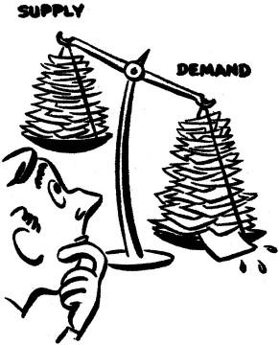

Plan:
Term of “Elasticity”;
Elasticity coefficient;
Elasticity of Demand;
Elasticity of Supply;
Conclusion.

Slide 3
Term of “Elasticity”
Elasticity
Alfred Marshall
“Elasticity” term
in 1885
Statistic and marketing quantities
Economic analysis

Slide 4

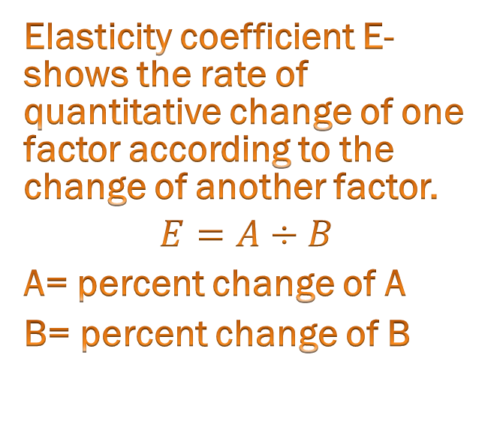
Elasticity coefficient
Elasticity coefficient E- shows the rate of quantitative change of one factor according to the change of another factor.
$$E=A÷B$$
A= percent change of A
B= percent change of B

Slide 5
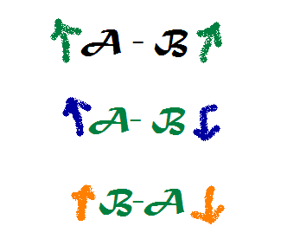
Dependence between A&B
POSITIVE
NEGATIVE

Slide 6

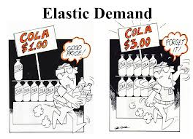

Elasticity of Demand
price elasticity of demand
income elasticity of demand

Slide 7
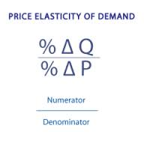
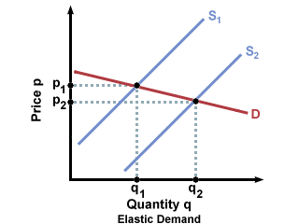
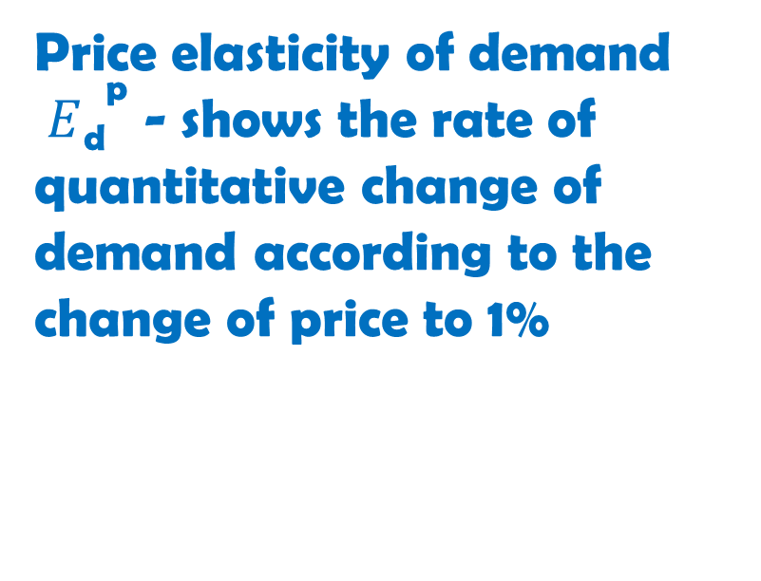
price elasticity of demand
Price elasticity of demand $E{\text{d}}^{\text{p} }$- shows the rate of quantitative change of demand according to the change of price to 1%

Slide 8
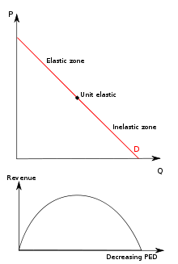
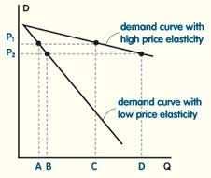
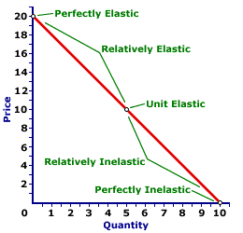
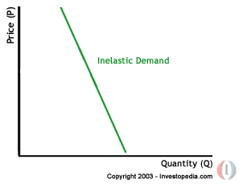

Slide 9
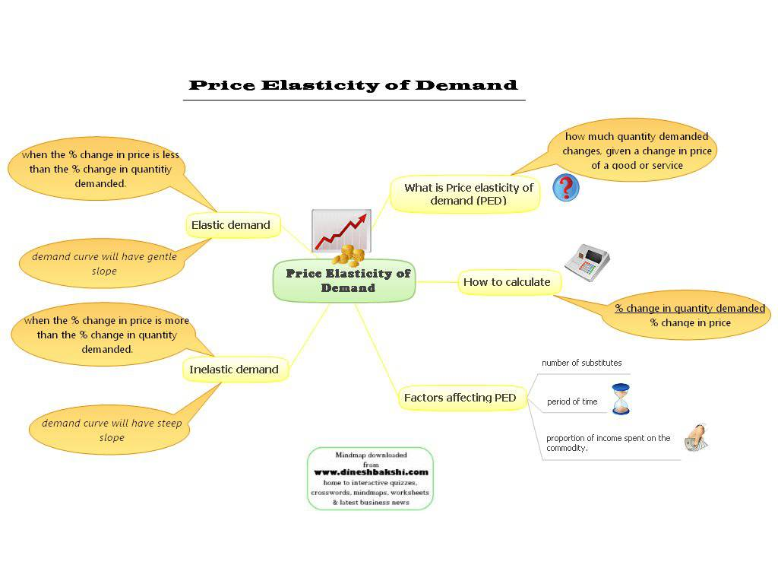

Slide 10
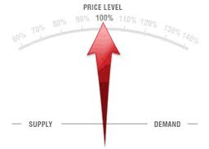
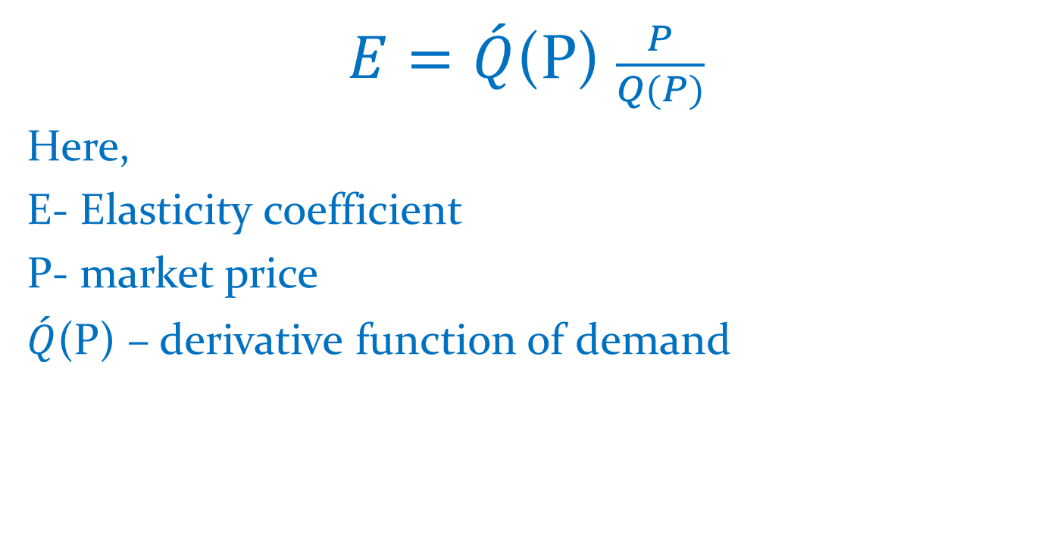
Point Elasticity method
$E=\acute{Q}$(P)$\frac{P}{Q(P)}$
Here,
E- Elasticity coefficient
P- market price
$\acute{Q}$(P) – derivative function of demand

Slide 11
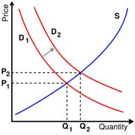
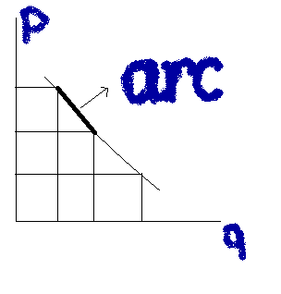
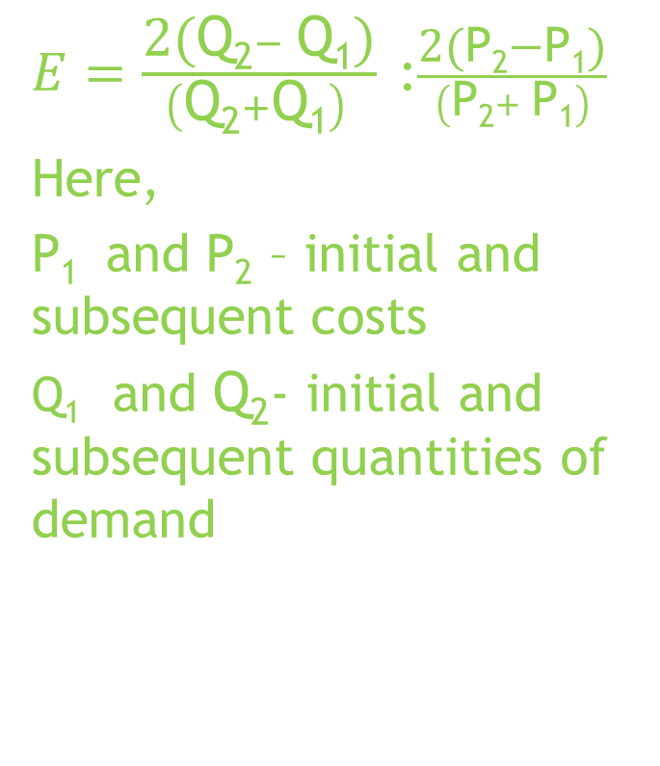
Arc elasticity method
$E=\frac{\text{2(}\text{Q}\text{2}− \text{Q}\text{1}\text{)}}{\left(\text{Q}\text{2}+\text{Q}\text{1}\right) }$:$\frac{\text{2(}\text{P}\text{2}\text{−}\text{P}\text{1}\text{)}}{\left(\text{P}\text{2}+ \text{P}\text{1}\right)}$
Here,
P₁ and P₂– initial and subsequent costs
$\text{Q}\text{1}$ and $\text{Q}\text{2}$- initial and subsequent quantities of demand

Slide 12
According to the Elasticity coefficient demand can be:
Demand is elastic
Ed>1
Demand is not elastic
Ed<1
Unit elasticity
Ed=1

Slide 13
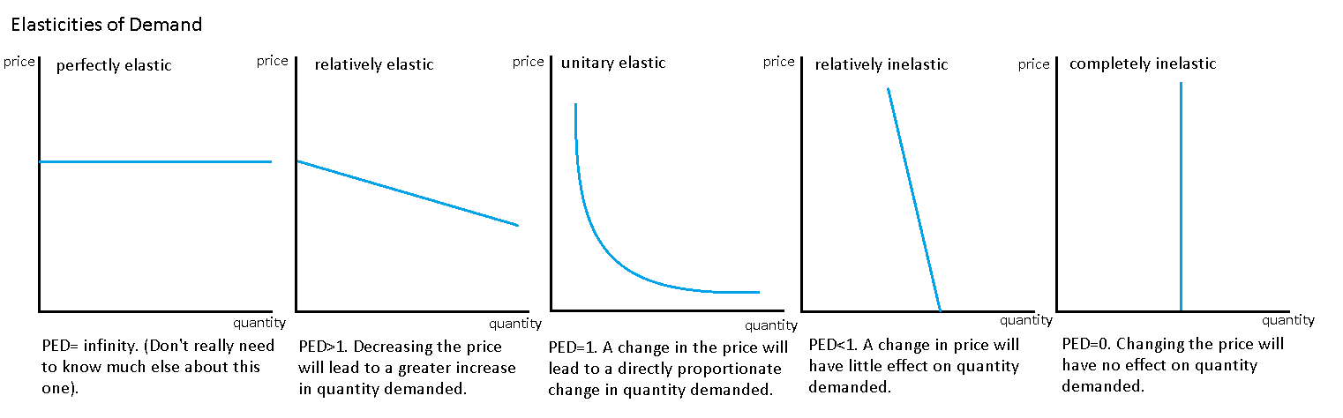

Slide 14
Factors that affect to price elasticity of demand
Presence and availability of substitute goods
Time factor
Unit weight of product`s expendi-ture
Necessity of the product to the costumer

Slide 15
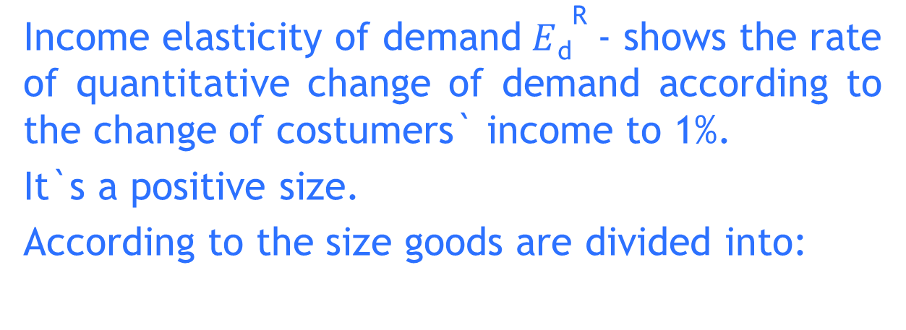
Income elasticity of demand
Income elasticity of demand$E{\text{d}}^{\text{R}}$- shows the rate of quantitative change of demand according to the change of costumers` income to 1%.
It`s a positive size.
According to the size goods are divided into:
first-necessity / essential goods
second-necessity goods
third-necessity goods

Slide 16
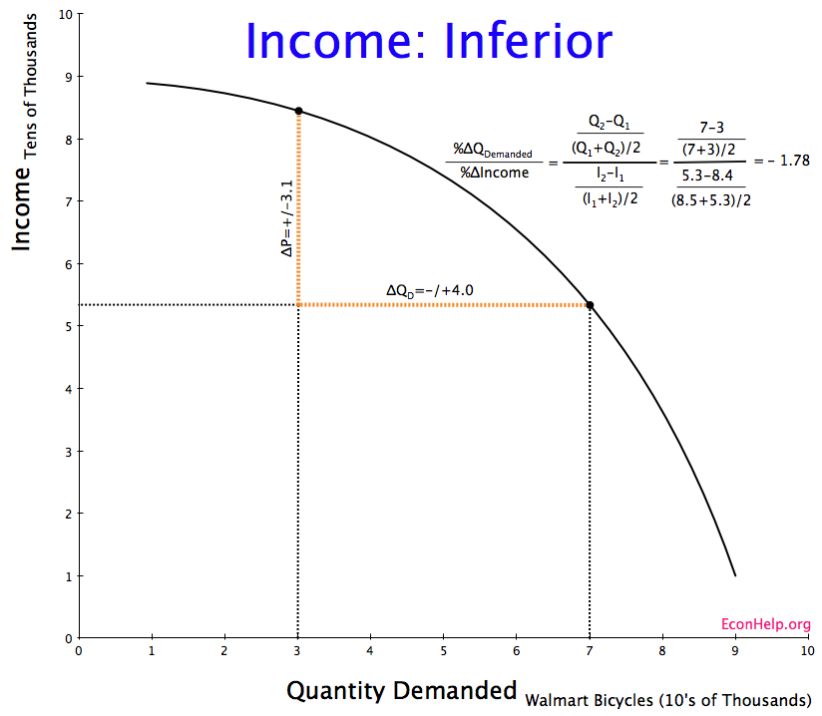

Slide 17


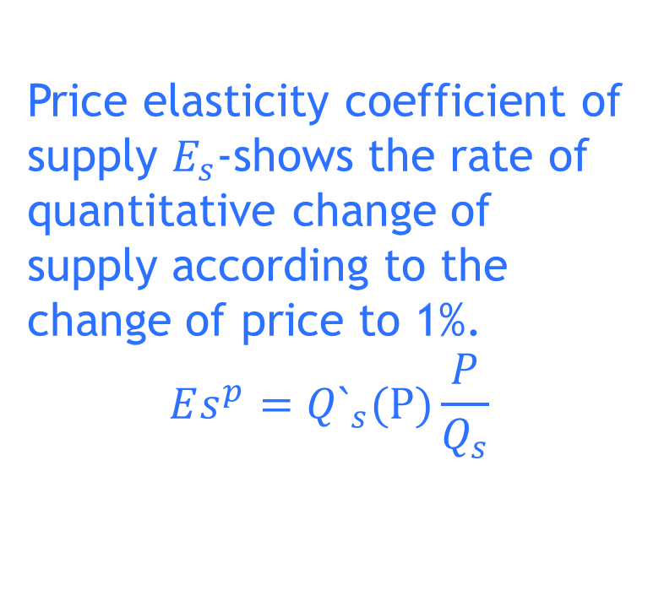
Elasticity of supply
Price elasticity coefficient of supply $E_{s}$-shows the rate of quantitative change of supply according to the change of price to 1%.
$$Es^{p}=Q`_{s}(P)\frac{P}{Q_{s}}$$

Slide 18
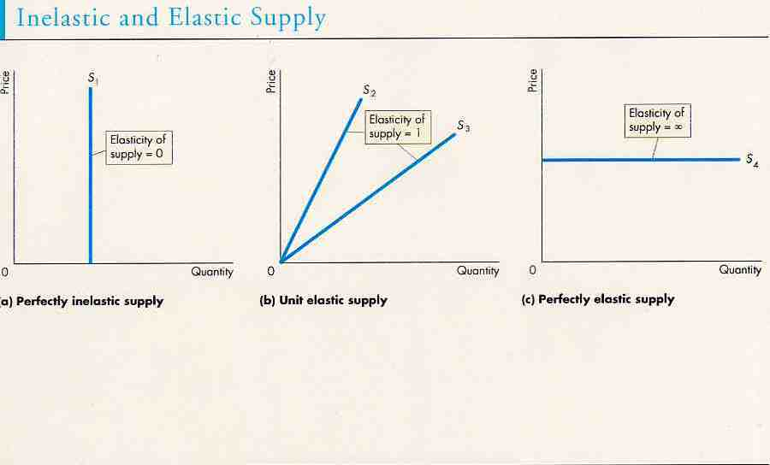

Slide 19
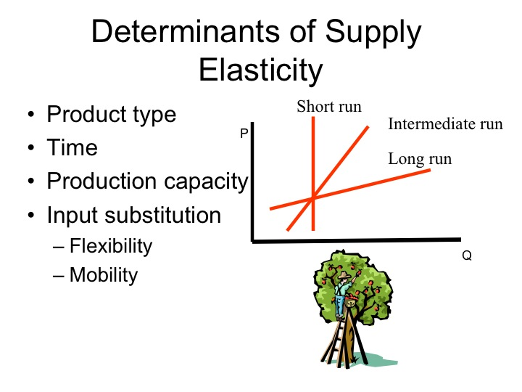

Slide 20
Factors that affect to price elasticity of supply
Presence of unloaded producing forces
kinds of goods and services prepared for selling
Opportunity of long-term storage of production
Minimum volume of expenditure necessary to the expansion of manufacturing
Period of time
economic activities(conjuncture) of the market

Slide 21
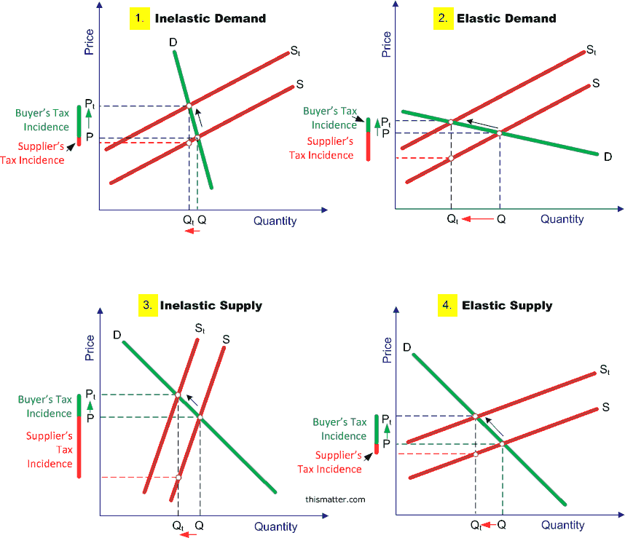
tax-incidence-supply-demand-diagrams

Slide 22


CONCLUSION:
Demand and supply elasticity are one of the main terms of micro economy and play efficient role in the market economy. With the help of demand and supply elasticity we can conduct very important economic analysis. Prices, revenue, market conjuncture depend on elasticity. Supply and demand elasticity assist to carry on statistic and analytic inquiries , marketing research, economic analysis.

Slide 23
REFERENCES:
“Mikroiqtisodiyot”: N. Xolmatov, N. Imomova, Toshkent-2012;
MBA :“Экономическая Теория”: И.К. Станковская,
И.А. Стрелец, Москва-2010;
http://www.tutor2u.net/economics/content/diagrams
http://thismatter.com/economics/images/tax-incidence-supply-demand-diagrams.png
http://economics-online.co.uk/Bussines

Slide 24

THANK YOU FOR YOUR ATTENTION!

